Slide 1
Concentration PhET Understanding Molarity and Parameters affecting Molarity
By Trish Loeblein
5/18/2014

Slide 2
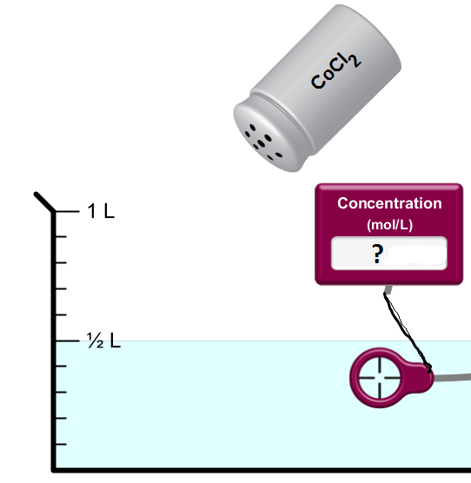
1. How many moles is 130 g of CoCl₂?
1.4 moles
1.0 moles
2.0 moles
Notes:
B 59 + 2*35.5 =130

Slide 3
2. What is the molarity of a solution with 130 g of CoCl₂ in ½ Liter?
1.4 molar
1.0 molar
2.0 molar
Notes:
C 59 + 2*35.5 =130 g/mole 1 mole/.5 liter = 2 molar

Slide 4
3. How many grams of of CoCl₂ in ½ Liter would be used to make a 1.0 molar solution?
65 g
130 g
260 g
Notes:
A 59 + 2*35.5 =130 g/mole .5 mole/.5 liter = 1 molar 130 *.5 = 65 g

Slide 5
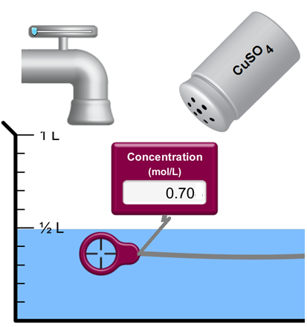
4. If water is added to a 0.70 molar solution of CuSO_{4,} what will change ?
Molarity will increase
Molarity will decrease
The amount of CuSO₄ will increase
The amount of CuSO₄ will decrease
No change in molarity or amount of solute
Notes:
B

Slide 6
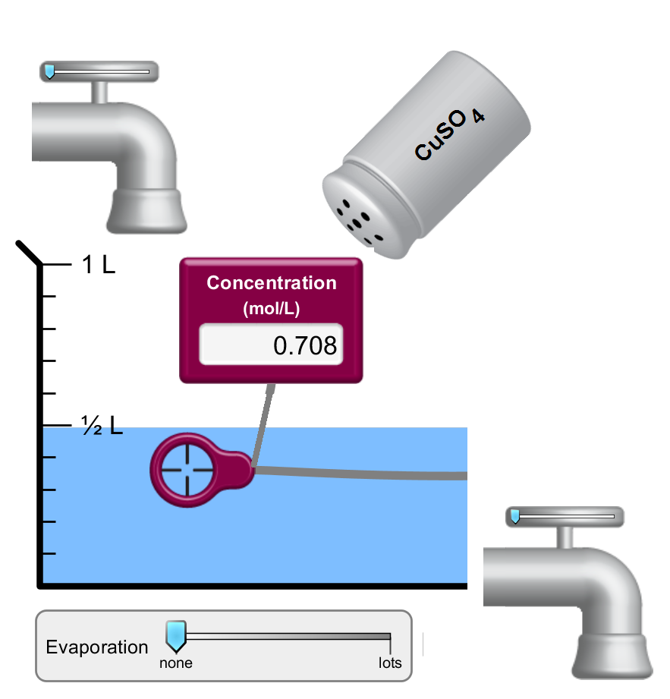
5. If evaporation occurs what will change 0.70 molar solution of CuSO₄?
Molarity will increase
Molarity will decrease
The amount of CuSO₄ will increase
The amount of CuSO₄ will decrease
No change in molarity or amount of solute

Slide 7
6. If some of the solution is drained out, what will change 0.70 molar solution of CuSO₄?
Molarity will increase
Molarity will decrease
The amount of CuSO₄ will increase
The amount of CuSO₄ will decrease
No change in molarity or amount of solute
Notes:
D

Slide 8
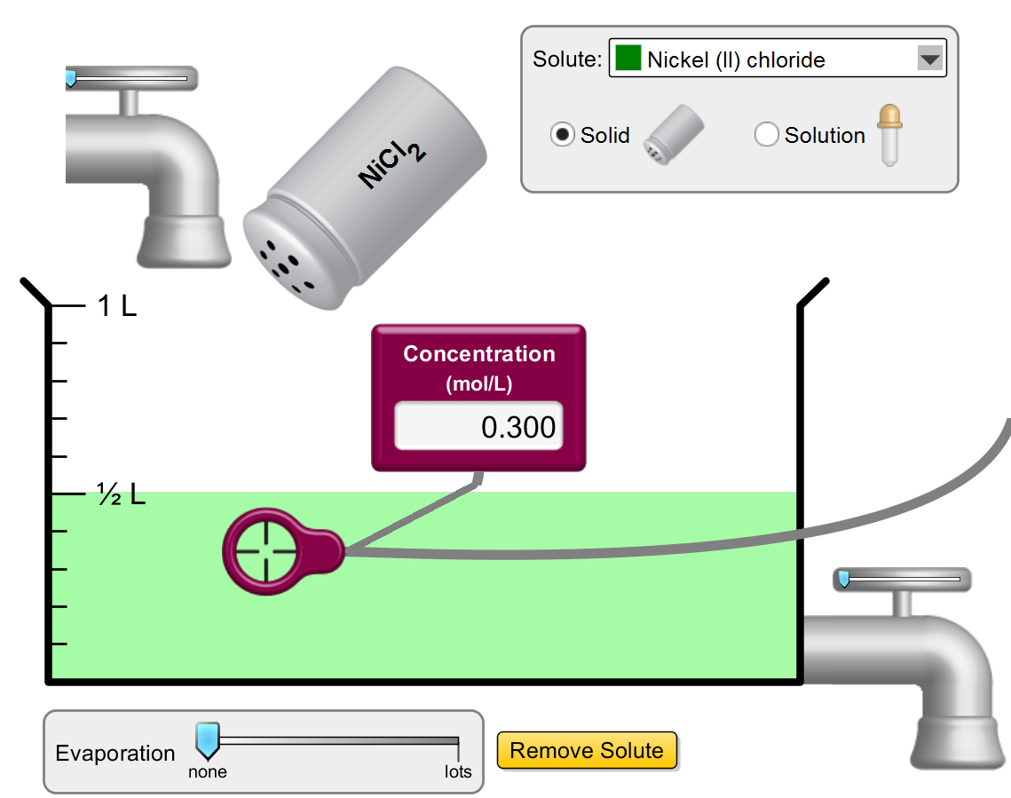
7. What will change if more solid NiCl₂ is added?
Molarity will increase
Molarity will decrease
The amount of NiCl₂ will increase
The amount of NiCl₂ will decrease
More than one of these
Notes:
E both A and C

Slide 9
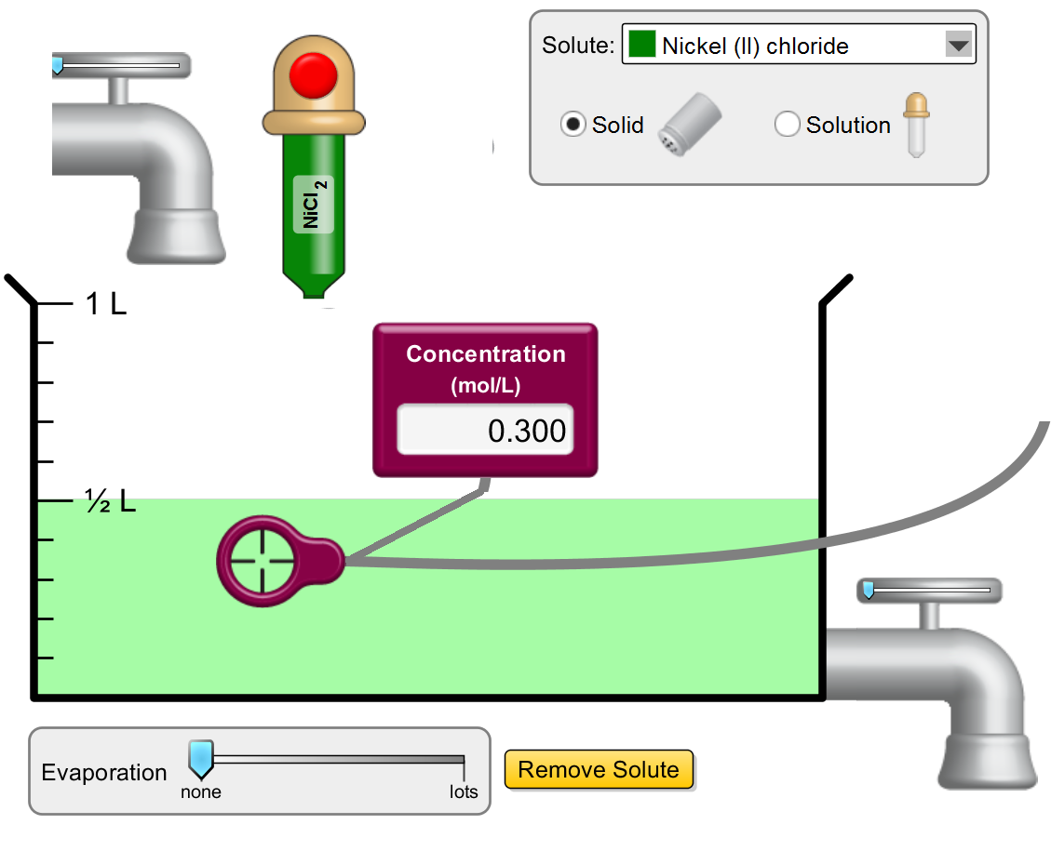
8. What will change if liquid 5.0 Molar NiCl₂ is added?
Molarity will increase
Molarity will decrease
The amount of NiCl₂ will increase
The amount of NiCl₂ will decrease
More than one of these
Notes:
E both A and C

