Slide 1

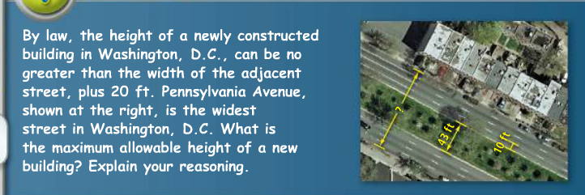
Ticket to Start: On your desk, or the whiteboard, answer the following question(s).

Slide 2
Agenda
Warm-up
Homework Point Sheets
PhET Activity/Exploration
Ticket to Leave

Slide 3
Objectives/ELRs – Chapter 3 Solving Inequalities
ELR 3.1 To read, write, graph, and identify solutions of inequalities

Slide 4
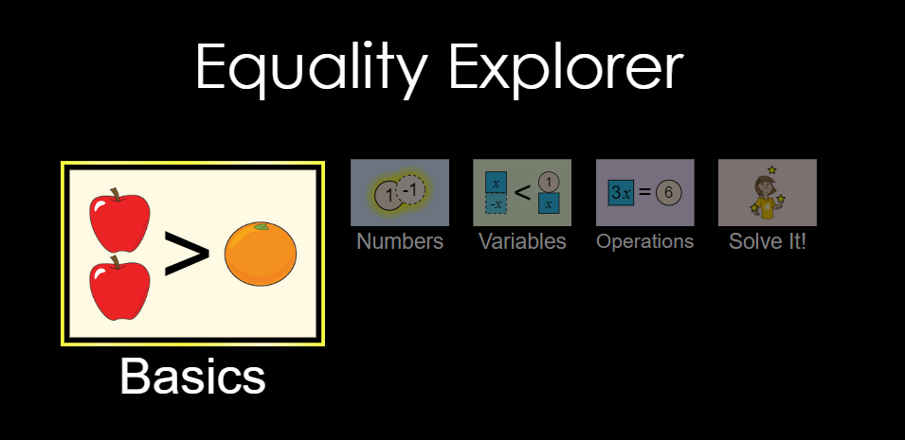
ELR 3.1 To read, write, graph, and identify solutions of inequalities
Goal 1: Reading Inequalities
Step 1: Using the PhET link on our classroom page, go to the Equality Explorer simulation.

Slide 5
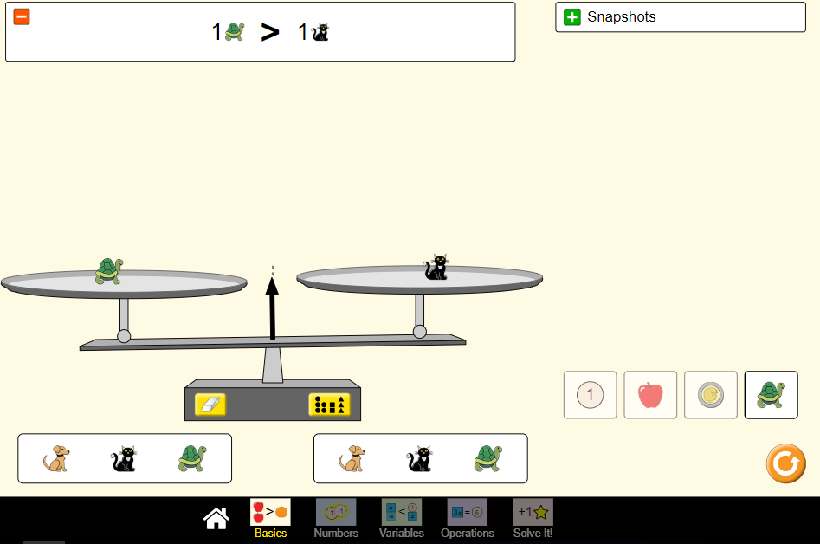
ELR 3.1 To read, write, graph, and identify solutions of inequalities
Step 2: Using the “Basics” tab use 5 minutes to play around and see what relationships you can find between the animals, fruit, and/or coins. Answer the questions on the activity sheet under “Goal 1: Reading Inequalities Exploration”. Once you have completed questions 1-6 pause to discuss your answers with your partner and with the class.

Slide 6
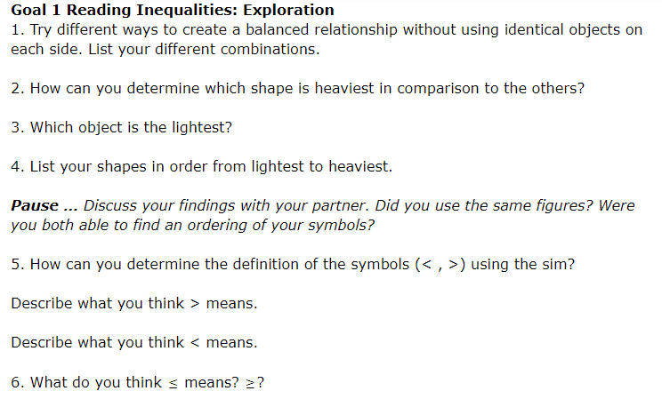
ELR 3.1 To read, write, graph, and identify solutions of inequalities

Slide 7
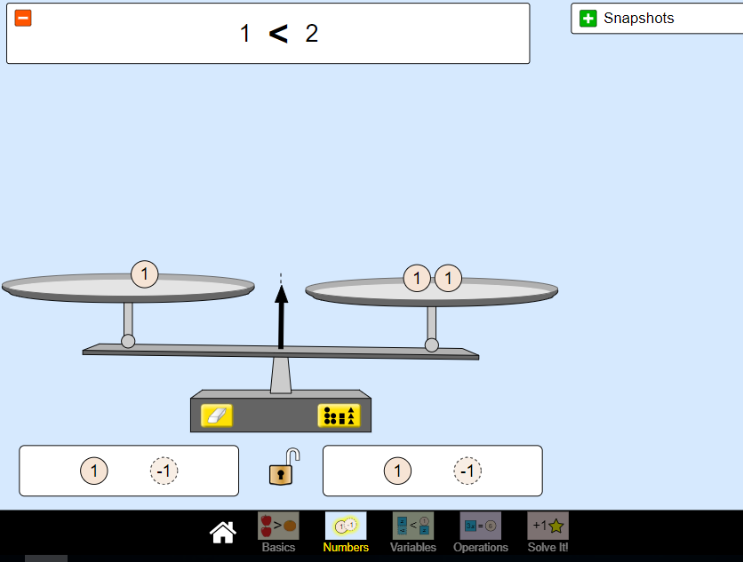
ELR 3.1 To read, write, graph, and identify solutions of inequalities
Step 3: Using the “Numbers” tab, create a numerical inequality of your choice. Answer the questions under “Goal 1: Reading Inequalities Numbers Activity”. Once you have completed questions 1-3 pause to discuss your answers with your partner and with the class.

Slide 8
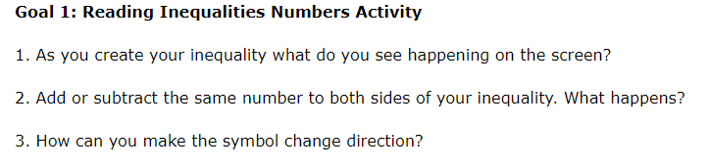
ELR 3.1 To read, write, graph, and identify solutions of inequalities

Slide 9
ELR 3.1 To read, write, graph, and identify solutions of inequalities
Step 4: As a class we will read the following inequalities out loud.
A. x < 3
B. x > -7
C. y ≥ 4
D. z ≤ 9
E. x > -1
F. 12 > x
G. -4 ≥ x
Class discussion: What does it mean to be a solution of an inequality? What are some solutions to the inequalities (A-G)? What are the pitfalls of having the variable on the right side in F-G when trying to list solutions? Is there a better way to write the inequalities? How would we do that? Should we always write inequalities with the variables on the left side?

Slide 10
ELR 3.1 To read, write, graph, and identify solutions of inequalities
Goal 2: Writing Inequalities Practice writing inequalities using words and symbols under the “Goal 2: Writing Inequalities” section on your activity sheet. Once you have completed parts A and B, pause to discuss your answers with your partner and with the class.

Slide 11
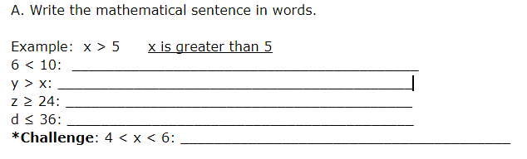
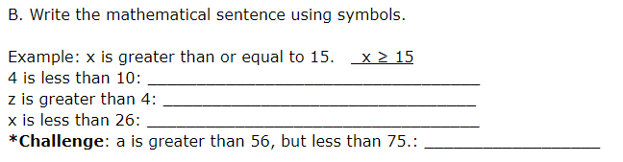
ELR 3.1 To read, write graph, and identify solutions of inequalities

Slide 12
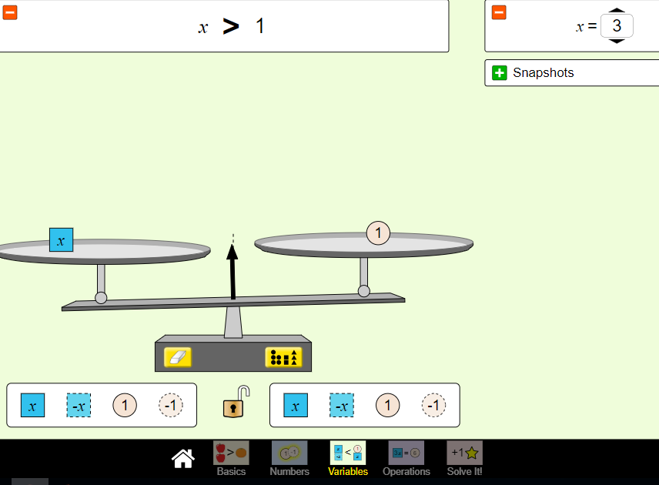
ELR 3.1 To read, write, graph, and identify solutions of inequalities
Goal 3: Graphing Inequalities
Step 1: Using the “Variables” tab, create an inequality with the variable on the left. Follow the directions/answer the questions on the activity sheet under “Goal 3: Graphing Inequalities Variables Activity”. Once you have completed 1-3, pause to discuss with your partner and with the class.

Slide 13
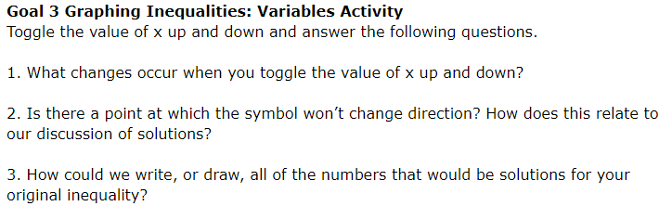
ELR 3.1 To read, write, graph, and identify solutions of inequalities

Slide 14
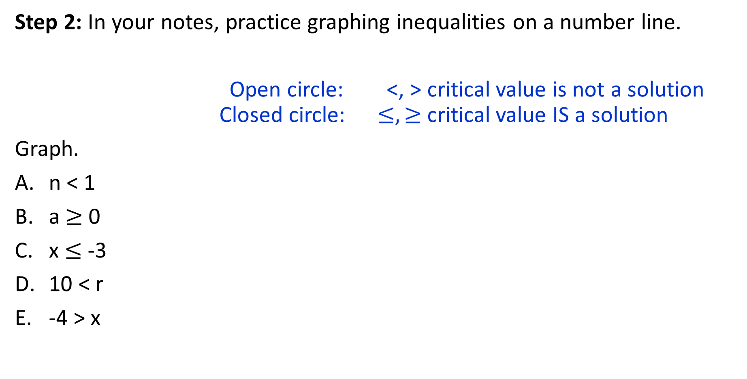
ELR 3.1 To read, write, graph, and identify solutions of inequalities
Step 2: In your notes, practice graphing inequalities on a number line.
Open circle: <, > critical value is not a solution Closed circle: $≤, ≥$ critical value IS a solution
Graph.
n < 1
a $≥$ 0
x $≤$ -3
10 < r
-4 > x

Slide 15




ELR 3.1 To read, write, graph, and identify solutions of inequalities
Step 3: In your notes, write the inequality for each graph.
A.
B.
C.
D.

Slide 16
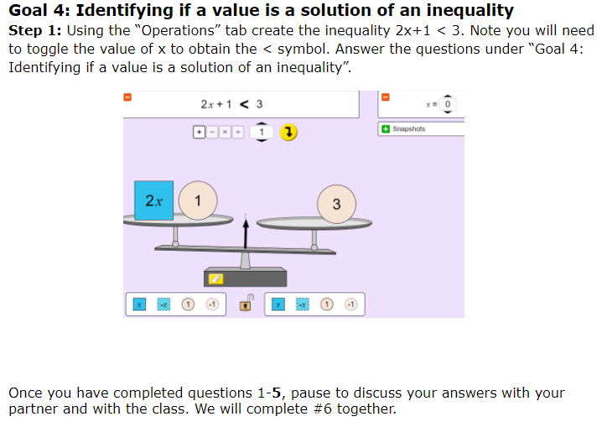
ELR 3.1 To read, write, graph, and identify solutions of inequalities

Slide 17
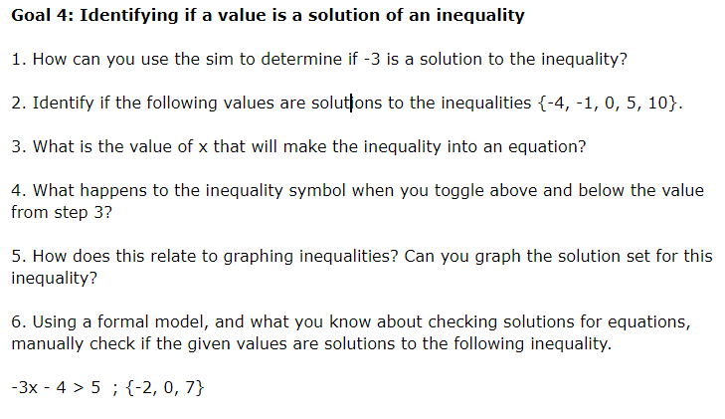
ELR 3.1 To read, write, graph, and identify solutions of inequalities

Slide 18
Ticket to Leave: On your ticket to leave, answer the following questions. Show all work.
A. Write the expression in words AND graph it on a number line.
x > -13
B. Is 4 a solution to 3x – 5 > 14?

