Slide 1
Equivalent Expression Exploration
PhET Sim Lesson

Slide 2
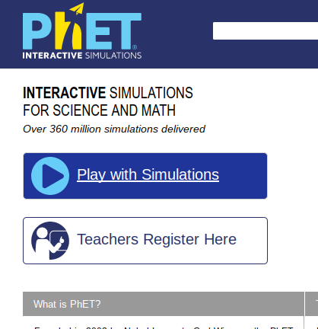
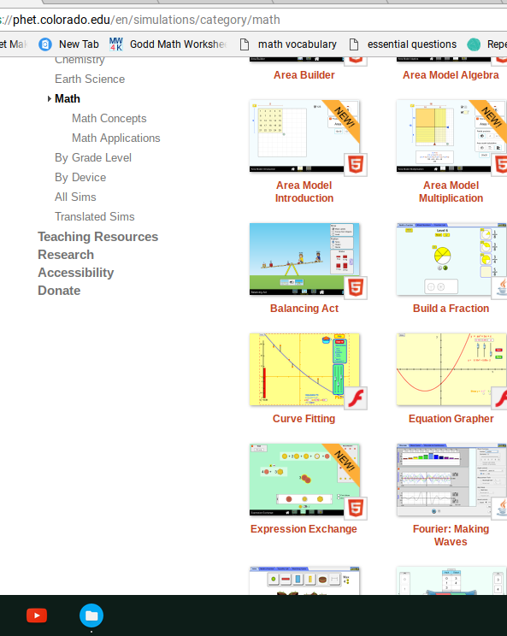
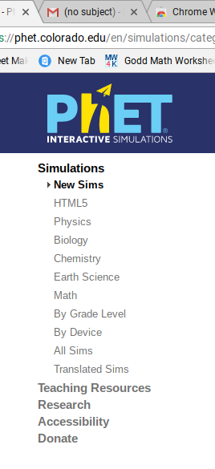
Go to the PhET site.
Click on the Play with Simulations Button.
Click on Math
Click on Expression Exchange.

Slide 3
Learning Goals
Students will identify like terms and combine them to simplify expressions.
Students will identify and create equivalent expressions.

Slide 4
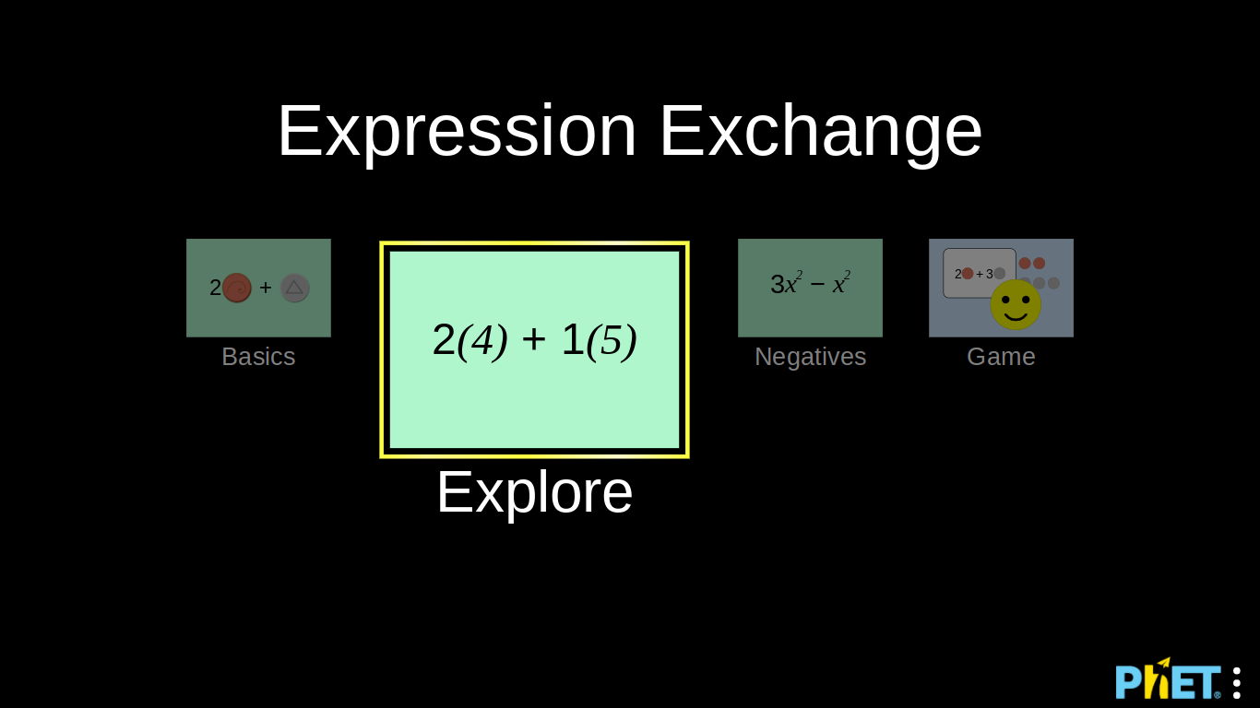
Click on the Explore box and explore the Sim for a few minutes.

Slide 5
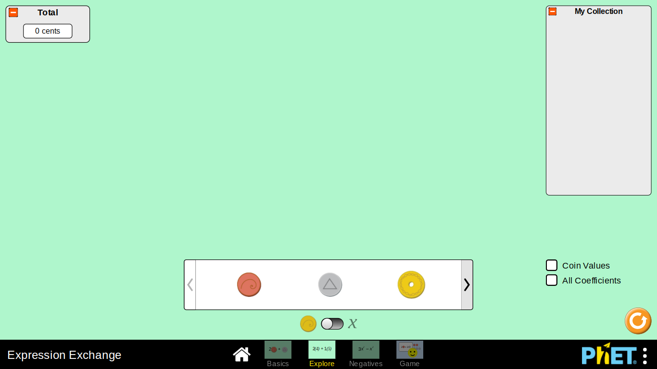
Consider the following questions while exploring:
What can you do or figure out with the sim?
What features of the sim might help us with the learning goals of the lesson? How? Write down at least 1 example.
Notes:
Walk around the room while students are exploring.
Ask questions about what they are doing.
Give students time to share out and demonstrate what they learned.

Slide 6
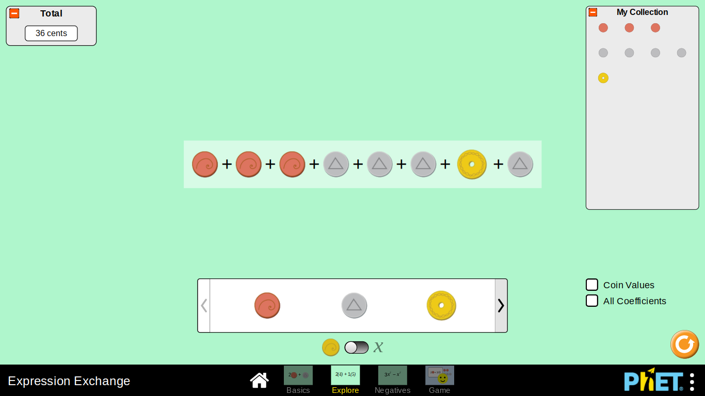
Use the sim to create this.
Notes:
Use this to show how to break apart and combine.
Review like terms, combining like terms, and coefficients.
Write those terms and their definitions on the whiteboard somewhere.

Slide 7
Part 1: Warm Up
Complete part 1 on your worksheet.
When you finish, compare with your partner.
Do you agree with what your partner said about like terms and coefficients?
When you finish, toggle from the coins to variables and try it again.
What do you notice?

Slide 8
Discussion Questions
What do you think the expression “combining like terms” means?
In the expression x + 4y, does the term x have a coefficient?
If not, why not?
If so, what is it?

Slide 9
Part 2: Making Equivalent Expressions
Complete 4 then stop and compare with your partner.
Did you have any expressions that are the same?
Did you have any expressions that were different?
Could you think of any different expressions together?
Complete 6-9, stop and compare with your partner.
Can you combine x and xy to get 2xy? Why or why not? Test you answer on the sim.
When you finish, try to complete higher levels on the game.

Slide 10
Discussion Questions
In Part 2 you had two different examples, one with coins and one with variables.
Which one did you like better? Which one made more sense? Why?
You and you partner have 60 seconds to come up with a definition for the term equivalent expression.
Notes:
Share out different definitions of equivalent expressions from students.

Slide 11
Part 3: What is simplest form?
Complete 8-10 and then turn and compare your answer with your partner.
Do not move onto 11 until you agree on an answer.
Complete 11-13 and then turn and compare your answer with your partner.
Was your strategy in the first example the same as your strategy in the first example?
Done so soon? Determine if any of the following expressions are in simplest form.
x + x + y + y + y
5x + 5y + z
2x + 2y + 2x

Slide 12
Discussion Questions
What does the word simple mean?
What is simplest form?
Why?
What does it mean to simplify expressions?
Simplify: 6x + 2y + x
Simplify: 9 + 12 ÷ 3 - 1

Slide 13


Exit Ticket
Develop a procedure for finding the simplest form of an algebraic expression.
Explain how to use that procedure to simplify one of the expressions below.

