Slide 1
Proportion Playground
Comparing Unequal Ratios

Slide 2
Warm Up
1) Create at least three fractions that are equivalent to ¾
2) Alice has $6 and Bob has $2. They combine their money to buy a pack of new pencils.
What is the ratio of Alice’s money to Bob’s money?
What fraction of the total money is Alice’s?
What fraction of the total money is Bob’s?
Suppose the pack of pencils contains 80 pencils. How many of the pencils should Alice get, and how many of the pencils should Bob get?
3) Are there any other ways to compare Alice’s and Bob’s money?

Slide 3
Learning Targets
I can create equivalent ratios.
I can compare unequal ratios in a real-world context involving concentration levels.

Slide 4
Proportion Playground
https://phet.colorado.edu/sims/html/proportion-playground/latest/proportion-playground_en.html

Slide 5

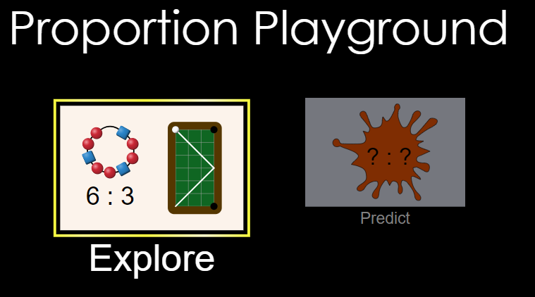
Take 5 minutes to work with the Explore part of the sim.
What do you notice?
Notes:
After 5 minutes, have students share out what they discovered with the app.

Slide 6
What do you notice about the paint splats that are the exact same color?
What can you learn from 2 paint splats that you cannot learn from seeing only one splat?

Slide 7
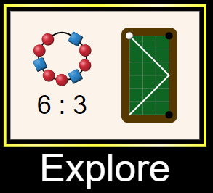

Activity Sheet Instructions:
Work with a partner.
Part A: Use the Explore part of the sim
Part B: Use the Predict part of the sim
We will come back together as a class after #5.

Slide 8
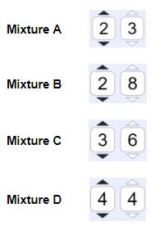
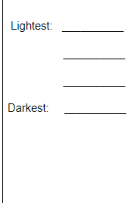
Strategies Discussion

Slide 9
Heather:
3/6 of mixture C is black paint.
Kathy:
3/9 of mixture C is black paint
Do you agree with Heather or Kathy? Justify your answer.

Slide 10
Heather:
3/6 of mixture C is black paint.
Heather is using a part to part ratio.
Kathy:
3/9 of mixture C is black paint
Kathy is using a part to whole ratio.
Notes:
For teachers using CMP 7th grade math, part to part and part to whole will be revisited in Problem 1.3 of Covering and Surrounding.

Slide 11
Use Kathy’s strategy to complete #6 and #7 on the worksheet.
Number of black balloons
Total number of balloons

Slide 12
Big Ideas for your notes
What strategies did you use to compare unequal ratios?

Slide 13
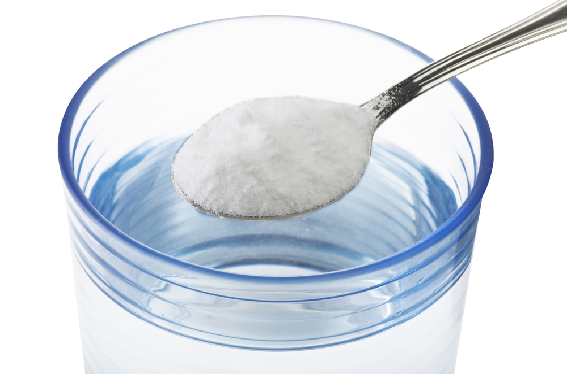
Exit Ticket
Saline Water Solution A
4 cups of water
1 cup of salt
Saline Water Solution B
7 cups of water
3 cups of salt
Which solution is saltier?
Show work and explain in words to justify your answer.

