Slide 1

Clicker Questions for
Molecule Shapes
AUTHORS:
Yuen-ying Carpenter (University of Colorado Boulder)
Robert Parson (University of Colorado Boulder)
Trish Loeblein (University of Colorado Boulder)
COURSE:
Introductory / Preparatory College Chemistry
COPYRIGHT: This work is licensed under a Creative Commons Attribution 4.0 International License.

Slide 2
What shape is water?
Tetrahedral
Bent
Trigonal planar
Linear
Notes:
Note that this question does not require expanded octets.
Goal: Connect Lewis structure of a familiar molecule to the name of the molecule geometry
Correct answer: B
Representative results from pre-general chemistry: 60-67% correct (remaining votes roughly split between C and D)
Follow-up discussion: Ask students about the lewis structure of water. Use the simulation (either the model or real molecules screen) to demonstrate the answer once a Lewis structure is agreed upon.

Slide 3
What is the electron pair geometry of NH₃?
Linear
Trigonal Planar
Tetrahedral
Trigonal Pyramidal
N has 4 groups around it;
thus, it is a tetrahedral electron
pair geometry
H
N
H
H
Answer: C
Notes:
Note that this question does not require expanded octets.
Goal: Contrast electron pair geometry with the more familiar molecule geometry of ammonia (often seen in textbook figures). Review Lewis structures.
Correct answer: C
Representative results from pre-general chemistry: 50-67% correct (next most popular answer is B)
Follow-up discussion: Ask students about the lewis structure of ammonia. Use the simulation (either the model or real molecules screen) to demonstrate the answer once a Lewis structure is agreed upon.

Slide 4
Which of these molecules has a linear molecule geometry?
CO₂
O₃
Both
Neither
Notes:
Note that this question does not require expanded octets.
Goal: Extend students application of VSEPR to unfamiliar molecules (carbon dioxide is frequently shown in textbooks as an examples, so many students recall their structure from memory without the need to apply geometry modelling or VSEPR). Ozone is less familiar.
Correct answer: A
Representative results from pre-general chemistry: 52% correct (next most popular answer is C)
Follow-up discussion: Ask students about the lewis structure of each. Use the simulation (either the model or real molecules screen) to demonstrate the answer once a Lewis structure is agreed upon. Follow-up slide can also be shown.
Note: While SO₂ provides a more obvious contrasting case to CO₂ than O₃ does (and SO₂ is shown in the real molecules screen of the sim), we chose to use ozone to avoid both the use of expanded octets. Additionally, there is some controversy concerning the best Lewis structure for SO₂ which instructors should be aware of. Some textbooks treat it as analogous to O3, with one single and one double bond, while others give it two single bonds and an extra lone pair on S (as shown in the simulation). Both Lewis structures lead to a bent geometry.

Slide 5
O₃ has 18 valence electrons:
O
O
O
O
O
O
The bonding in ozone is best represented as a
a blend of these two “resonance structures”.
Notes:
For follow-up discussion to previous question.

Slide 6
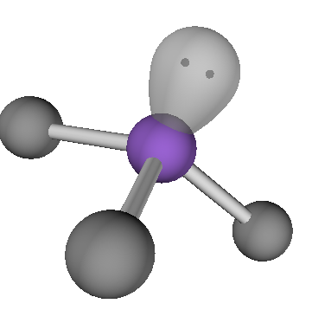
Which molecule could be represented with this diagram?
BH₃
CH₄
NH₃
Notes:
Note that this question does not require expanded octets.
Goal: Connect 3D representations to students’ Lewis structure drawings, contrasting the first row elements.
Correct answer: C
Representative results from pre-general chemistry: 70-80% correct (next most popular answer is A)
Follow-up discussion: Ask students about the number of valence electrons of B vs N.

Slide 7
What is the molecular geometry of H₂S?
Linear
Tetrahedral
Trigonal pyramidal
Bent
Answer: D
S
H
H
Notes:
Note that this question does not require the use of expanded octets.
Goal: Extend students application of VSEPR to unfamiliar molecules (water and ammonia are frequently shown in textbooks as examples, so many students recall their structure from memory without the need to apply geometry modelling or VSEPR)
Correct answer: D
Representative results from pre-general chemistry: 71% correct (next most popular answer is A)
Follow-up discussion: Ask students about the lewis structure then use the simulation (either the model or real molecules screen) to demonstrate the answer once a Lewis structure is agreed upon

Slide 8
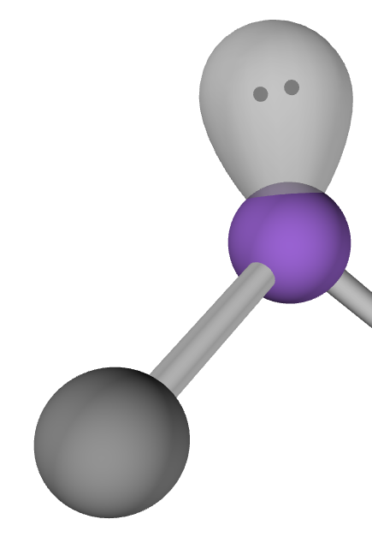
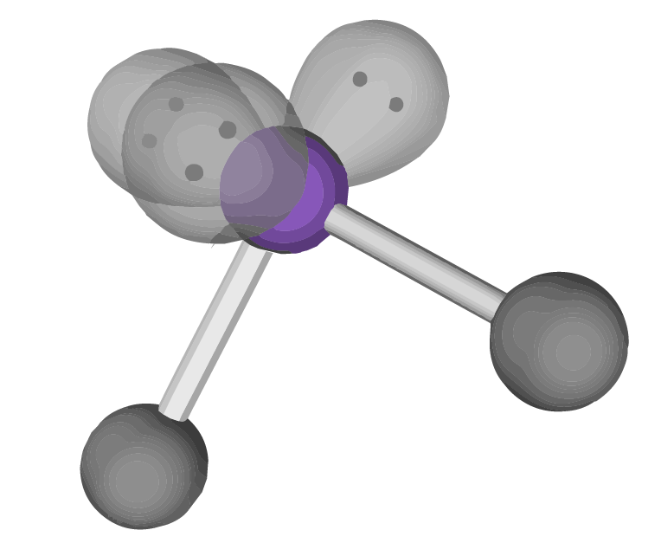
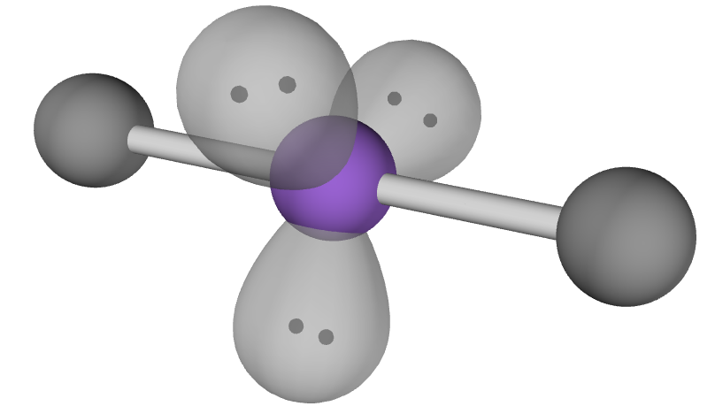
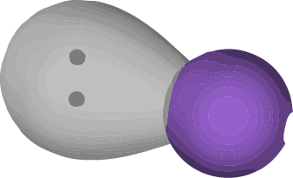
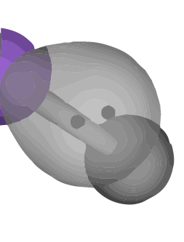
What is the molecule geometry and bond angle for a molecule AX₂ which has 3 lone pairs on the central atom?
A
B
C
Bent
Bond angle ≈ 90°
Bent
Bond angle ≈ 120°
Linear
Bond angle ≈ 180°
Explain your reasoning.
Notes:
Note that this question does not require students to have mastered Lewis structures but does involve expanded octets.
Goal: Have students rationalize lone pair vs. bond orientation in axial vs. equatorial sites of a trigonal bipyramidal electron geometry, where not all positions are equidistant from each other.
Correct answer: C
Follow-up demo to accompany discussion: Ask students whether the preferred geometry maximizes spacing between bond pairs or lone pairs (since the linear geometry happens to do both). Use the simulation with 5 bonded atoms on the central atom and bond angles shown to indicate which angles are 120° and which are 90°. To help students distinguish clearly between the 3 co-planar atoms and the remaining two atoms, you can build the molecule with differing bond orders. To do this, add bonds in the following order: (1) double, (2),(3),(4) single, and (5) double, resulting 3 co-planar singly bonded atoms. Build AX₂E₃ with the 2 atoms and 3 lone pairs and demonstrate that any attempts to rearrange the positions of the substituents re-equilibrates to the linear geometry.

Slide 9
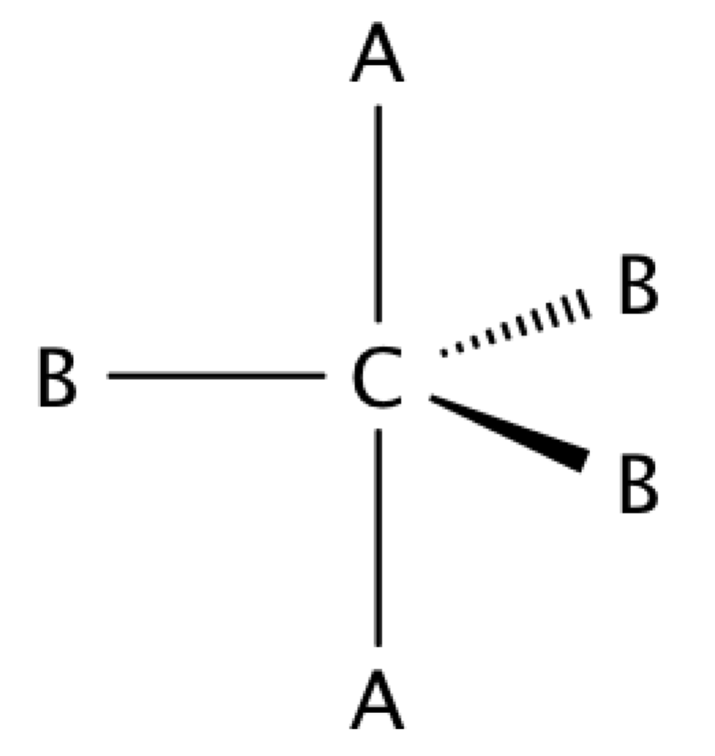
In a system with 4 atoms and 1 lone pair, predict the position of the lone pair.
One of the A locations
One of the B locations
Explain your reasoning.
Notes:
Alternative to previous question. Note that this question does not require students to have mastered Lewis structures but does involve expanded octets.
Goal: Have students rationalize lone pair vs. bond orientation in axial vs. equatorial sites of a trigonal bipyramidal electron geometry, where not all positions are equidistant from each other.
Correct answer: B
Follow-up demo to accompany discussion: Ask students whether the preferred geometry maximizes spacing between bond pairs or lone pairs (since the linear geometry happens to do both). Use the simulation with 5 bonded atoms on the central atom and bond angles shown to indicate which angles are 120° and which are 90°. To help students distinguish clearly between the 3 co-planar atoms and the remaining two atoms, you can build the molecule with differing bond orders. To do this, add bonds in the following order: (1) double, (2),(3),(4) single, and (5) double, resulting 3 co-planar singly bonded atoms. To demonstrate the model geometry, you can use the model version of SF₄ in the Real Molecules screen of the simulation.

Slide 10
Which of these molecules would you expect to have different bond angles in the real world than are predicted by the model?
A
B
C
F
F
F
F
C
F
F
S
F
F
Xe
F
F
F
F
Explain your reasoning.
Notes:
Note that this question does not require students to have mastered Lewis structures but does involve expanded octets.
Goal: Predict when real molecules may have bond angles that deviate from ideal (equal) model angles.
Correct answer: B
Follow-up discussion: Ask students how they predicted that there would be a deviation from model bond angles. Discuss examples with no lone pairs, and also compare the contrasting examples B and C which both have lone pairs but are not both shown to deviate from model geometry. Also, ask students if they expect the real world (measured) bond angles to be smaller than or larger than those in the model. If desired, this can also be extended to comment on molecules with different substituents with unequal size (steric demand). Each molecule can be modelled with the Real Molecules screen of the simulation except CF₄, for which methane can be used as a substitute. Use the Real and Model radio buttons to compare and contrast.
Note: Although other explanations such as Bent’s rule may have stronger theoretical basis, VSEPR bond angle deviation predictions are sufficient for the level of detail required for this question.

