Slide 1

Clicker Questions for
Energy Skate Park: Basics
AUTHORS
Trish Loeblein (University of Colorado Boulder)
Robert Parson (University of Colorado Boulder)
COURSE
Introductory / Preparatory College Chemistry
COPYRIGHT: This work is licensed under a Creative Commons Attribution 4.0 International License.

Slide 2
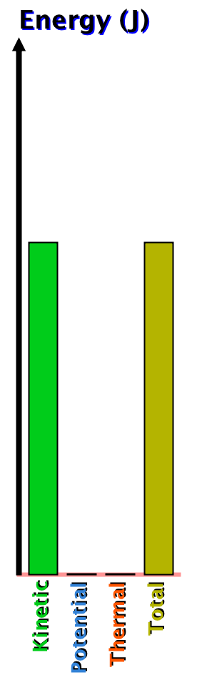
At some point, the skater had the energy shown in this graph.
Describe his speed at that point.
He is at his maximum speed
He is stopped
He is going his average speed
He is going slow
He is going fast
Notes:
Sim demonstration: Open the simulation and explore the skateboarder’s behavior with no friction, but without displaying the bar graph during the demonstration.
Correct answers: A
Representative results from pre-general chemistry: 53-63% correct (next most popular was C between 25-30%)

Slide 3
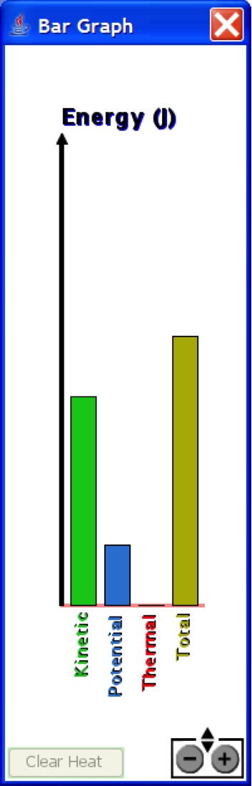
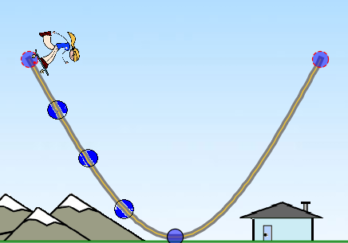
The bar graph shows the energy of the skater. Where could she be on the track?
A
B
C
D
E
Answer: D
Notes:
Sim demonstration: Open the simulation and explore the skateboarder’s behavior with no friction, but without displaying the bar graph during the demonstration.
Correct answer: D
Representative results from pre-general chemistry: 62-69% correct (next most popular was C at 20-30%)
Follow-up discussion: Ask students how they determined their answer, and discuss conservation of mass. Ask students how they determined their answer, and discuss conservation of mass. It may also be worthwhile discussing points C vs. D and how the change in potential energy is related to height (depending on how many students vote C vs. D).

