Slide 1

Clicker Questions for Concentration
AUTHORS:
Yuen-ying Carpenter (University of Colorado Boulder)
Robert Parson (University of Colorado Boulder)
Trish Loeblein (University of Colorado Boulder)
COURSE:
Introductory / Preparatory College Chemistry
COPYRIGHT: This work is licensed under a Creative Commons Attribution 4.0 International License.

Slide 2
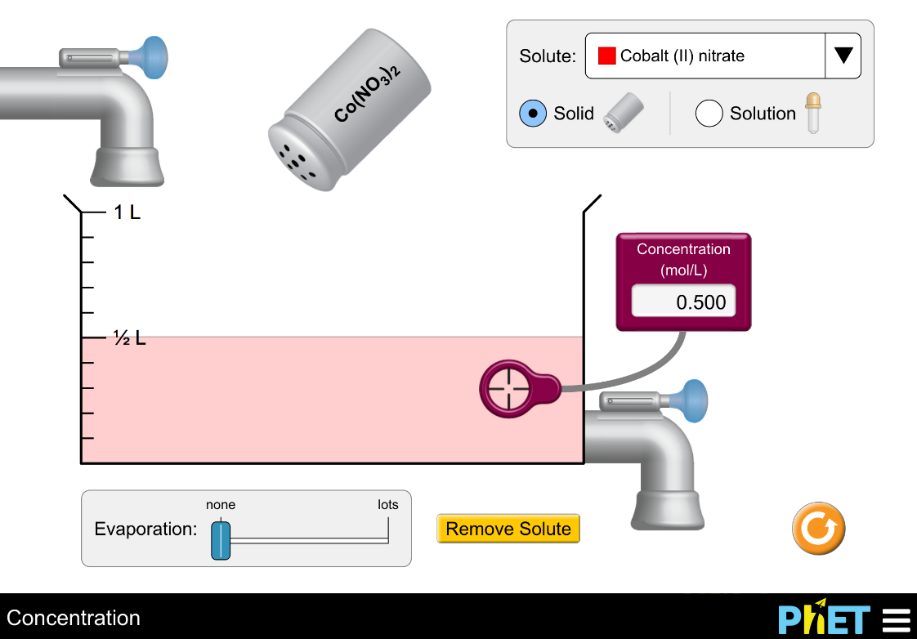
Which action(s) will increase the concentration of the solution?
Add more Co(NO₃)₂
Evaporate water
Drain solution
(1) only
(1) and (2)
(2) and (3)
(1) and (3)
(1), (2), and (3)
Notes:
Sim directions: Show students the various features available in the simulation -- use both faucets, add more solid from the salt shaker, evaporate some of the solution – initially without the concentration probe in solution. Comment on changes in solution colour, then use the concentration probe to show how concentration increases or decreases in response to these actions. Use Drink Mix for initial demonstrations as it gives students a real-world connection that they often find more intuitive for building an understanding of terms like dilute and concentrated, and for understanding what impacts concentration. Use sim observations to construct a definition of concentration before asking the following concept questions.
Correct answer: B
Representative results from pre-general chemistry: 85% correct (remaining students evenly distributed among other answers)
Follow-up discussion: Use the simulation to demonstrate each of the options given, and discuss as a class.
Note that setting up a specific starting solution is easiest if you create a slightly more concentrated solution and then dilute with water as needed (water faucets have higher precision control), and then drain any excess solution away.

Slide 3
Which action(s) will change the
number of moles of solute in the container?
Add water
Evaporate water
Drain solution
(1) only
(2) only
(3) only
(1) and (2)
(2) and (3)
Notes:
Goal: Extend students observations of concentration (from the simulation) to the relationship between moles and concentration.
Correct answer: C
Representative results from pre-general chemistry: 62% correct (21% selected D)
Follow-up discussion: Summarize the observations, and ask the class the effect of each these actions on concentration, in parallel.

Slide 4
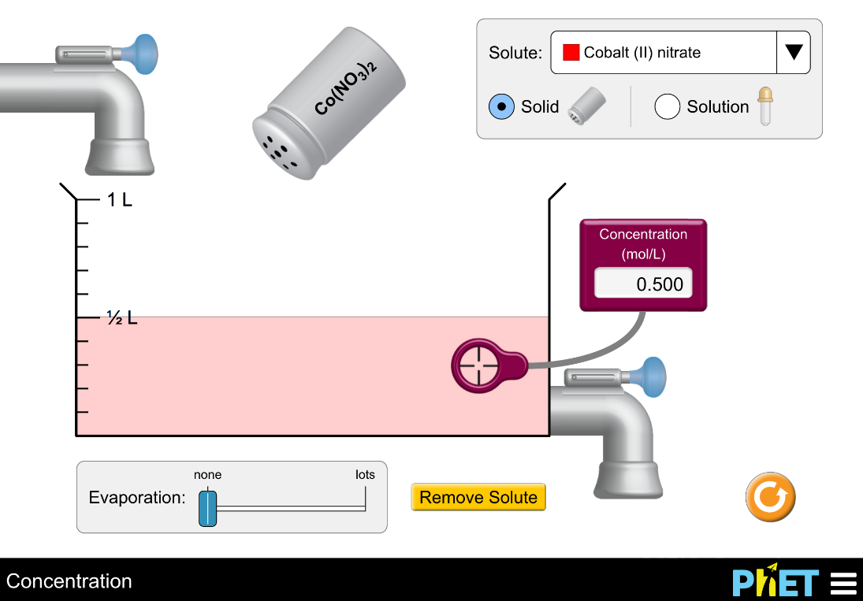
What will happen to the concentration and the number of moles when water is added?
Concentration Number of moles
Increase Decrease
Increase Increase
No change No change
Decrease Decrease
Decrease No change
Notes:
Correct answer: E
Representative results from pre-general chemistry: 86-89% correct (remaining students evenly distributed between other answers)

Slide 5

How many moles of solute are in the beaker?
a. 0.05 moles b. 0.50 moles c. 1.00 moles
d. 1.50 moles e. None of these
Notes:
Goal: Have students begin to think about concentration quantitatively
Correct answer: C
Representative results from pre-general chemistry: 63% correct (B and C are popular alternate answers)
Follow-up discussion: Ask students how many moles are in the beaker, and how they figured that out. Ask students to discuss with their peers, and offer the suggestion of thinking about how many moles would be in 1L of this same solution.

Slide 6
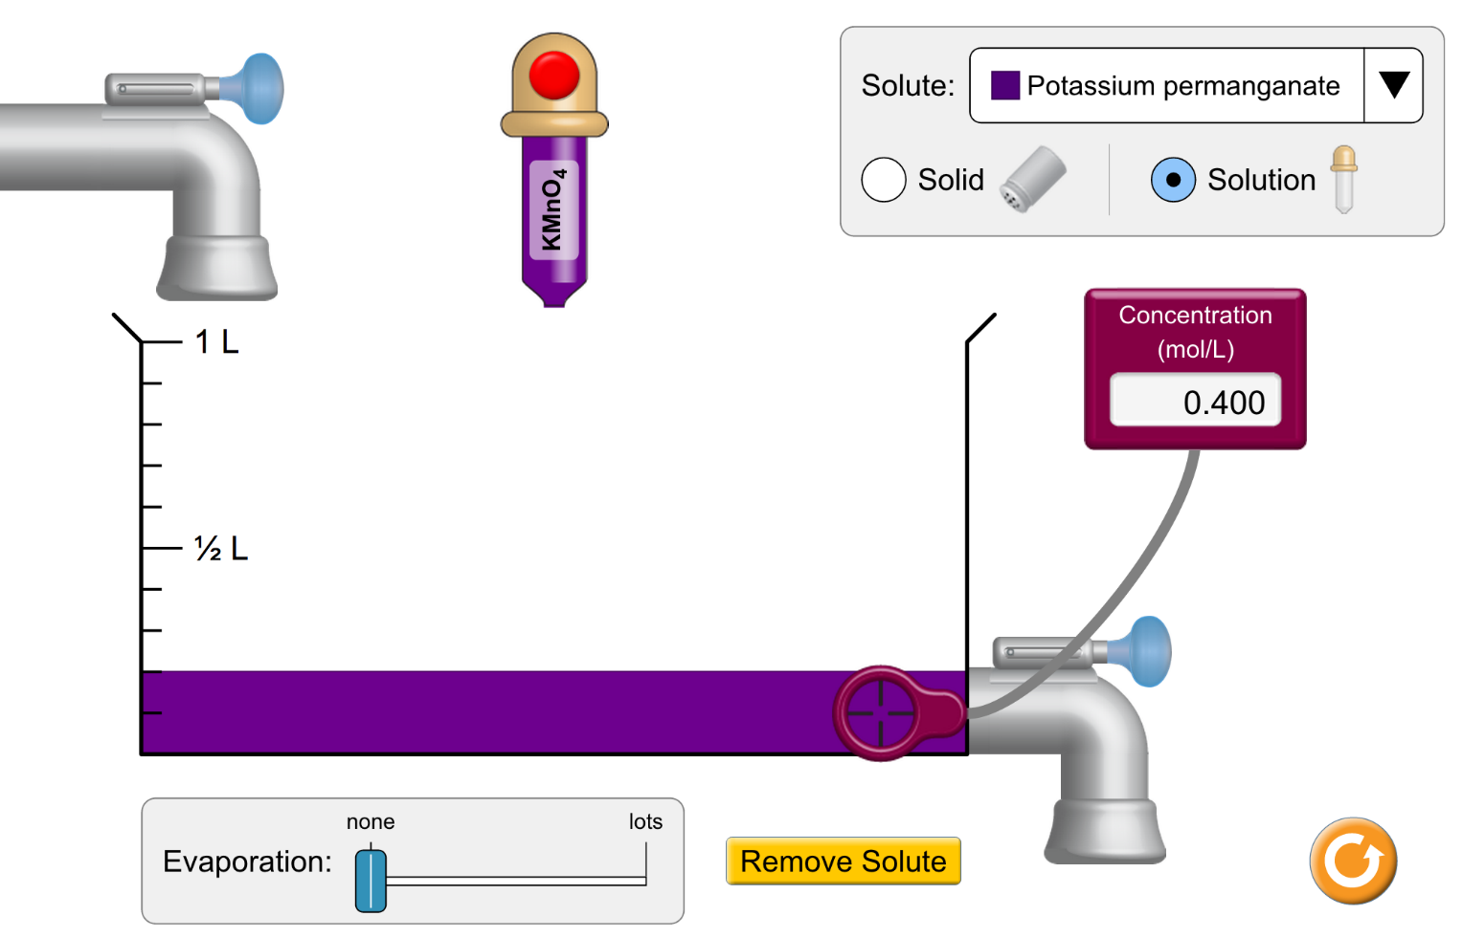
You are given 200 mL of a 0.400 M solution of KMnO₄.
If you add water until total volume is 800 mL, what will be the final concentration of the solution?
a. 0.080 M
b. 0.10 M
c. 0.20 M
d. 0.40 M
e. 1.6 M
Notes:
Goal: Introduce dilution (in this case of stock solutions) with simple numbers to promote proportional reasoning prior to calculation.
Correct answer: B
Follow-up discussion: Discuss whether a calculator is needed to solve this problem, and how students approached the question.

Slide 7
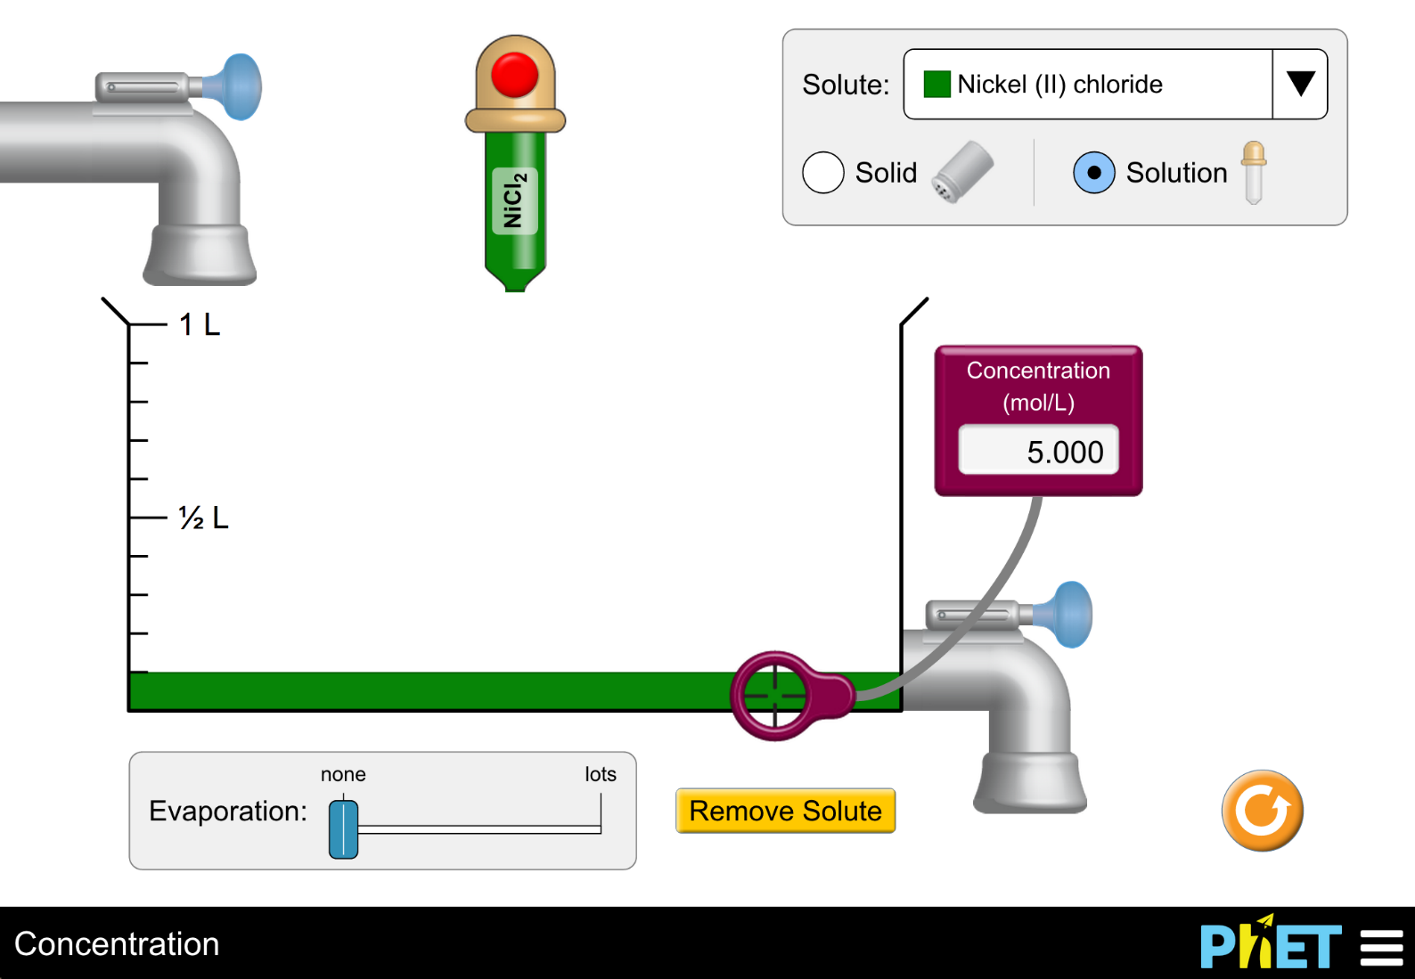
You start with 0.1 L of a 5.00 M solution of NiCl₂, and you plan to dilute it (by adding water) to make a solution with a concentration of 0.625 M. How far should you fill the beaker?
a. 200 mL
b. 400 mL
c. 600 mL
d. 800 mL
e. 1 L
Notes:
A computation-based dilution problem
Correct answer: D
Representative results from pre-general chemistry: 81% correct (C is the next most popular answer at 10% student responses)

Slide 8
You have prepared a 1.0 M solution of NaCl in the laboratory.
What is the concentration of chloride ions in the solution?
a. 0.50 M
b. 1.0 M
c. 1.5 M
d. 2.0 M
Notes:
Multi-sim question: Sugar and salt solutions + Concentration
Goal: The following four questions extend students’ conception of concentration to ion concentrations.
Correct answer: B
Representative results from pre-general chemistry: 55% A and 37% B
Follow-up discussion: Review the nature of ionic compounds using the Sugar and Salt Solutions simulation (Micro tab) to demonstrate the ratio of sodium to chloride ions. Use the pause/play feature to count ions in the solid, and count the ions in solution, to show that the total number of ions is the same. Highlight the ion concentration shown on the graph. Ask students to discuss how many moles of sodium ions are in one mole of NaCl, and then relate this to concentration.

Slide 9
You have prepared a 1.0 M solution of CaCl₂ in the laboratory.
What is the concentration of chloride ions in the solution?
a. 0.50 M
b. 1.0 M
c. 1.5 M
d. 2.0 M
Notes:
Multi-sim question: Sugar and salt solutions + Concentration
Correct answer: D
Representative results from pre-general chemistry (on first poll): Votes roughly even split between A, B, and D
Follow-up discussion: Ask students what the component ions are in CaCl₂, confirming that the anion is chloride, not Cl₂. Use the Sugar and Salt Solutions simulation (Micro tab) to demonstrate the ratio of calcium to chloride ions. Use the pause/play feature to count ions in the solid, and count the ions in solution, to show that the total number of ions is the same. Highlight the ion concentrations shown on the graph, where chloride is roughly double that of calcium.
Representative results from pre-general chemistry (on second poll, following peer discussion): 83% correct

Slide 10
Conductivity pairs
Which of these solutions will have higher conductivity?
A | B | C
0.1 M KCl_{(aq)} | 0.2 M KCl_{(aq)} | Not enough information
Notes:
Multi-sim question: Sugar and salt solutions + Concentration
Correct answer: B
Representative results from pre-general chemistry: 91% correct
Follow-up discussion: Ask students about the concentration of each ion and discuss how conductivity is impacted by ion concentration

Slide 11
Conductivity pairs
Which of these solutions will have higher conductivity?
A | B | C
0.1 M KCl_{(aq)} | 0.1 M CaCl_{2 (aq)} | Not enough information
Notes:
Multi-sim question: Sugar and salt solutions + Concentration
Correct answer: B
Representative results from pre-general chemistry: 66% correct (with a roughly even split between the other two options)
Follow-up discussion: Ask students how they determined the higher conductivity solution – students have previously asked why this dissociates into 2 Cl⁻ instead of 1 Cl₂²⁻ since chlorine occurs naturally as Cl₂. Other students responded to this query with ideas about ion charges and the absence of charge on molecular Cl₂ gas.

