Slide 1

Clicker Questions for Balancing Chemical Equations
AUTHORS:
Yuen-ying Carpenter (University of Colorado Boulder)
Robert Parson (University of Colorado Boulder)
Trish Loeblein (University of Colorado Boulder)
COURSE:
Introductory / Preparatory College Chemistry
COPYRIGHT: This work is licensed under a Creative Commons Attribution 4.0 International License.

Slide 2
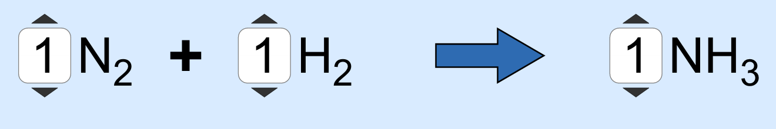
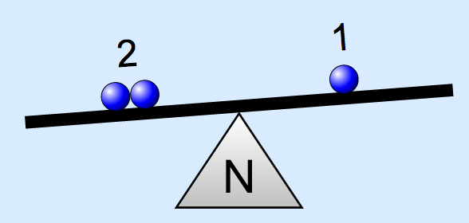
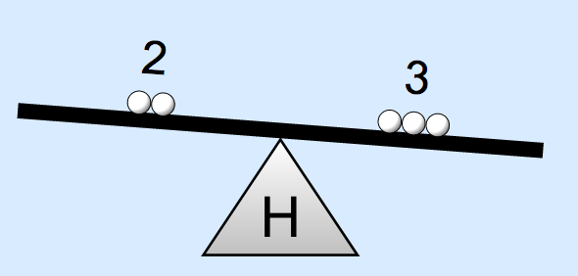
What would you do to balance this equation?
Double the coefficient of N₂ ( 2 N₂ )
Multiply coefficient of H₂ by 3 ( 3 H₂ )
Multiply subscripts of H₂ by 3 ( H₆ )
Double the subscripts for NH₃ ( N₂H₆)
Double the coefficient of NH₃ ( 2 NH₃)
Notes:
Goal: Practice balancing an easy equation (equivalent in difficulty to Level 1 of the Game in the simulation) by changing coefficients, not subscripts.
Correct answers: B or E
Representative results from pre-general chemistry: Roughly 30% B and 40-50% E if only one answer allowed.
Follow-up discussion: Students share out their routes, highlighting that there are multiple ways to go about solving the problem, but some choices are definitely wrong (e.g. can’t change subscripts.)

Slide 3
What was your first step in balancing this equation?
SO₃
SO₂ + O₂
Change the coefficient of SO₃
Change the coefficient of SO₂
Change the coefficient of O₂
Does not have a
“correct” answer,
but A is the most efficient
way
Notes:
Goal: Practice balancing an easy equation (equivalent in difficulty to Level 1 of the Game in the simulation), highlighting that there isn’t a single route to a balanced equation.
Correct answers: Any answer is viable.
Representative results from pre-general chemistry: 70% A (again, suggesting a systematic left-to-right approach).

Slide 4
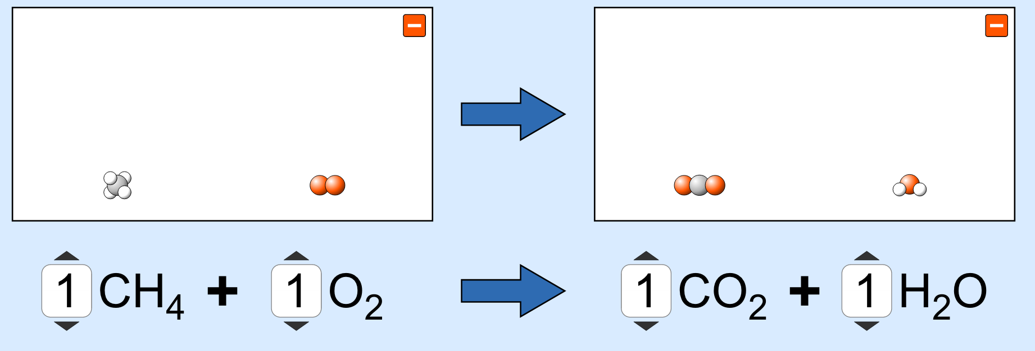
What was your first step in balancing this equation?
Change the coefficient of CH₄
Change the coefficient of O₂
Change the coefficient of CO₂
Change the coefficient of H₂O
Does not have a
“correct” answer –
All choices will work,
B and D are the most
efficient
Notes:
Goal: Practice balancing an intermediate difficulty equation (equivalent in difficulty to Level 2 of the Game in the simulation), highlighting that there isn’t only one route to a balanced equation.
Correct answers: Any answer is viable.
Representative results from pre-general chemistry: 72% D (likely suggests that students are moving systematically from left to right, and since C is already balanced, they balance H next).

Slide 5
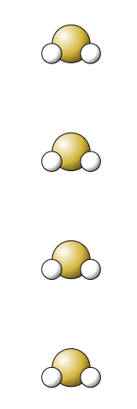
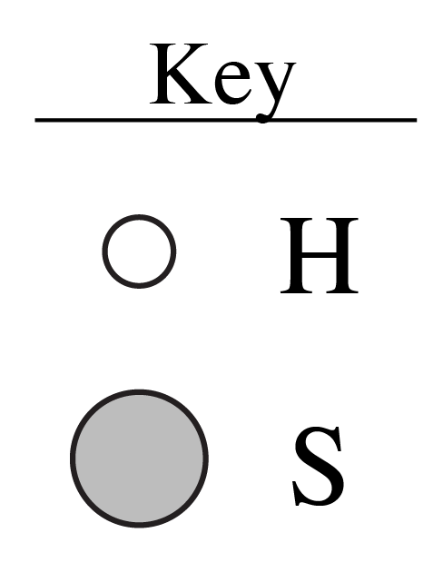

Which of these chemical formulas describes the contents of the box above?
4 SH₂
(SH₂)₄
Both A and B
Neither A nor B
Notes:
Goal: Review meanings of coefficients vs subscripts using atom representations from the sim and a molecule used in several equations (if students need additional review, suggest using Build a Molecule simulation)
Correct answer: A
Representative results from pre-general chemistry: 48% A and 44% C
Follow-up discussion: Draw pictures showing how subscripts and coefficients differ, even though the total number of atoms is the same. Ask students to discuss simple examples like H₂ vs. 2H.

Slide 6
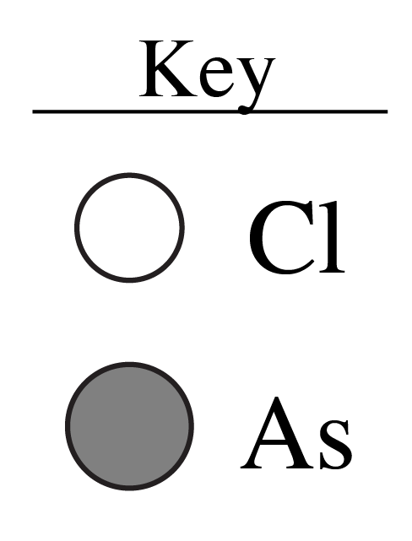
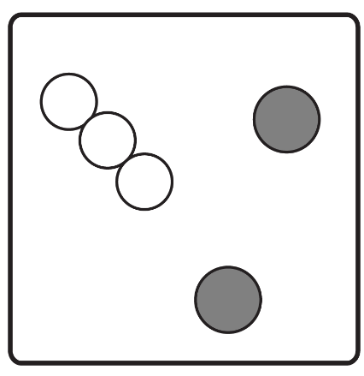
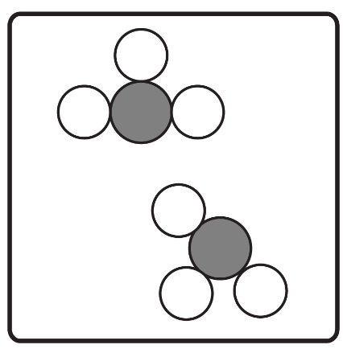
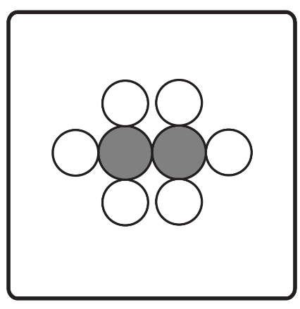
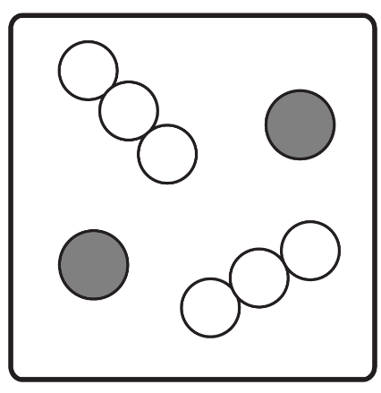
Which of the boxes below contains a picture representing 2 AsCl₃?
A
B
C
D
Notes:
Goal: Review meanings of coefficients vs subscripts
Correct answer: B
Representative results from pre-general chemistry: 96% correct (this question immediately followed the previous clicker question discussion)

Slide 7
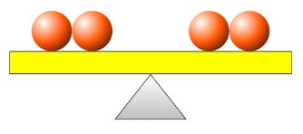
Balancing Chemical Equations
How many coefficients need to be changed to make this chemical equation balanced?
Zn(s) + HNO₃(aq) → Zn(NO₃)₂(aq) + H₂(g)
None
1
2
3
4
Balanced equation:
Zn(s) + 2 HNO₃(aq) → Zn(NO₃)₂(aq) + H₂(g)
Notes:
Goal: Practice balancing a moderately complex chemical equation (roughly equivalent in difficulty to Level 2 of the Game in the simulation)
Correct answer: B
Representative results from pre-general chemistry: 69% correct
Follow-up discussion: Ask for a student volunteer to balance the equation (what is the coefficient that needs to be changed, and to what?). This is also a good opportunity to discuss least coefficients, since the equation is still ‘balanced’ if we then double all the coefficients in the answer, but we use least coefficients by convention.

Slide 8
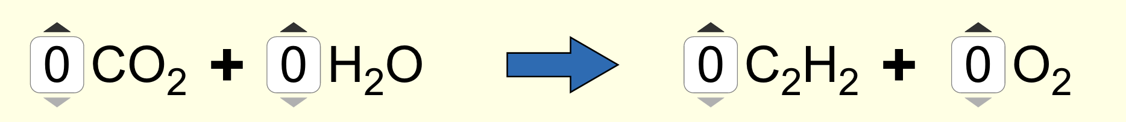
Balancing Chemical Equations
After you balance this equation, what is the final coefficient in front of O₂?
2
3
4
5
Notes:
Goal: Practice balancing a more challenging equation (one of the least challenging examples from Level 3 of the Game in the simulation)
Correct answer: D
Representative results from pre-general chemistry: 59% correct (next most popular: 22% chose B)
Follow-up discussion: Emphasize whole number coefficients, least coefficients, and that there is no one path to the answer. Use the next slide to highlight that even experts modify their coefficients in the process of balancing, so double-check that things are balanced at the end.

Slide 9
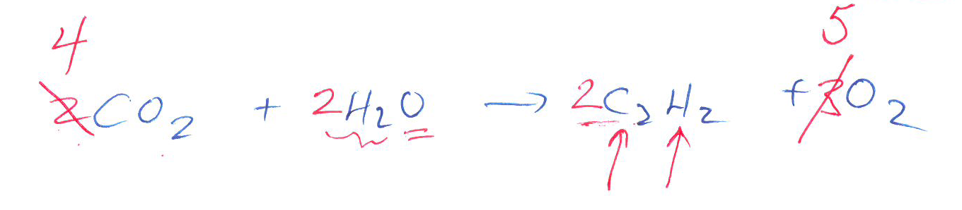
Balancing Chemical Equations
Unbalanced equation:
Balancing in progress:
Notice that it is NORMAL that you’ll revise your coefficients (possibly more than once) as you work towards a balanced equation, since changing one coefficient may affect an element that you previously balanced.
Balanced equation:
4
2
2
5
Notes:
Follow-up discussion from previous slide – suggest student or instructor think-out loud demo of balancing process

Slide 10
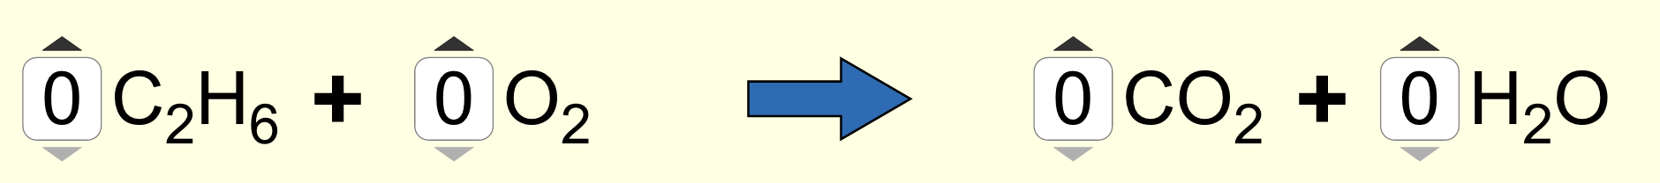
Balancing Chemical Equations “Level 3” – More challenging
Press ‘A’ on your clicker when you think you have correctly balanced this equation.
Notes:
Allow students time to balance this relatively difficult equation before asking the clicker question on the next slide. Use the clicker prompt to get a sense of class progress.

Slide 11
Balancing Chemical Equations “Level 3” – More challenging
What is the coefficient of H₂O in the balanced equation?
2
3
4
6
Notes:
Goal: Practice a challenging example of balancing a chemical equation (Level 3 of the simulation game)
Correct answer: D
Representative results from pre-general chemistry: 73% correct
Follow-up discussion: Walk through (instructor demo or student volunteer) balancing process, highlighting a less than perfect efficiency route and that fractional coefficients are not allowed

Slide 12
Balancing Chemical Equations Starting from words
When white phosphorus (P₄) is exposed to oxygen gas (O₂), it begins to burn, producing tetraphosphorus decaoxide.
Is this the correctly balanced chemical equation for this reaction?
4 P + 5 O₂ → P₄O₁₀
Yes.
No.
Impossible to determine.
Notes:
Goal: Review and reinforce that the meanings of subscripts and coefficients are different. Extend balancing to word equations and naming compounds.
Correct answers: B
Representative results from pre-general chemistry: First vote (mostly individual) nearly even split between Y/N. Second vote after peer discussion (with a prompt asking students to explain their reasoning to their neighbour) 81% correct

