Slide 1

Clicker Questions for Isotopes and Atomic Mass
AUTHORS:
Yuen-ying Carpenter (University of Colorado Boulder)
Robert Parson (University of Colorado Boulder)
Trish Loeblein (University of Colorado Boulder)
COURSE:
Introductory Chemistry
COPYRIGHT: This work is licensed under a Creative Commons Attribution 4.0 International License.

Slide 2

What would this be?
Carbon-12
Carbon-14
Oxygen-14
More than one of these
Notes:
Goal: Review this notation for isotopes
Correct answer: B
Representative results from pre-general chemistry (when used as review of previous material): 93% correct

Slide 3


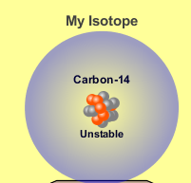
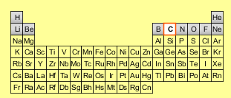
Reason: The number of protons tells the name of the atom; the mass is given by the sum of protons and neutrons
6 protons +8 neutrons
Notes:
Follow-up discussion to previous clicker Q

Slide 4
Which of these pairs of atoms are isotopes?
 | Pair A |  | Pair B |  | Pair C
# of protons | 6 | 8 | 5 | 2 | 12 | 12
# of neutrons | 8 | 8 | 5 | 3 | 12 | 14
Notes:
Goal: Review the relationship between isotopes before discussing average atomic mass
Correct answer: C
Representative results from pre-general chemistry (when used as review of previous material): 88% correct

Slide 5
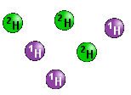
What is the approximate average mass of a hydrogen atom in this sample?
6 amu
2 amu
1.5 amu
1 amu
Notes:
Sim directions: (optional) Close the Average atomic mass feature in the 2nd tab of the sim, and use sim (2nd tab) to build this sample
Correct answer: C
Representative results from pre-general chemistry: 100% correct (incorrect options were based on total mass, one of the isotopes, and the value on periodic table)
Follow-up discussion: See next slide

Slide 6
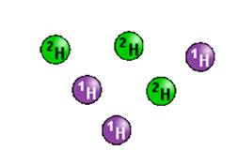
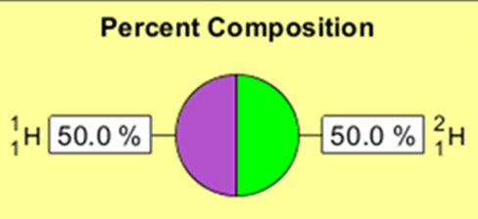
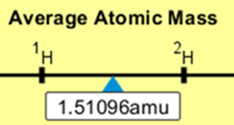
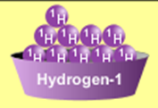
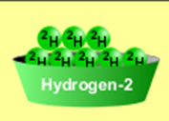
3/6 gives 50% of each, so… 0.5*2 + 0.5*1 = 1.5 amu or 3*2 + 2*1 = 1.5 amu
Reason:
Why are there more digits in the answer in the sim?
Notes:
Follow-up discussion to previous clicker Q:
Note that when students were asked how they got their answer, they more often use the actual number of atoms of each, divided by the total, instead of using percentages.
Can also use the simulation to discuss the difference between isotopic mass and mass number. Dragging any single isotope into the box on the 2nd tab will give you the isotopic mass to 5 decimal places.

Slide 7
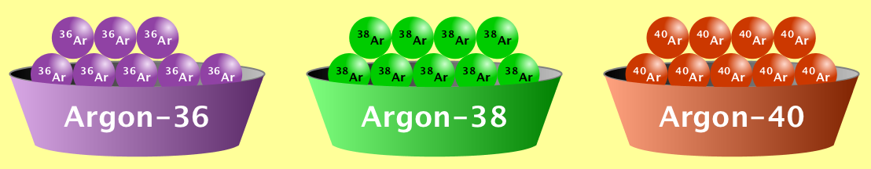
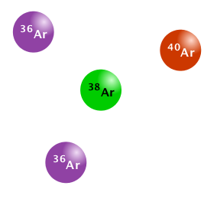
What is the approximate average mass of an argon atom in this sample?
40 amu b. 38 amu c. 37.5 amu
Notes:
Sim directions: (optional) Close the Average atomic mass feature in the 2nd tab of the sim, and use sim (2nd tab) to build this sample
Correct answer: C
Representative results from pre-general chemistry: Ranged from 60-80% correct (2nd most popular choice was B)
Follow-up discussion: See next slide

Slide 8
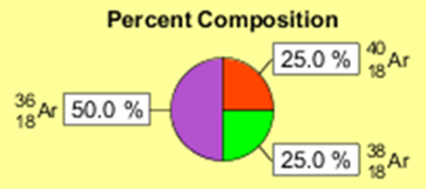
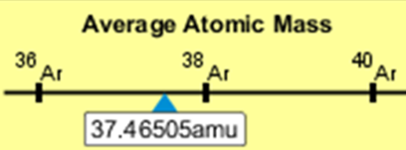
Calculation: 0.5*36 + 0.25*38 + 0.25*40 = 37.5 amu
Notes:
Follow-up discussion to previous clicker Q: Can use this discussion question to connect averages calculated using number of atoms (which students typically find much easier) vs. % composition

Slide 9
Mass of 1 atom
= 6.01512 amu
Mass of 1 atom
= 7.01600 amu
6.41548
Is the average atomic mass closer to the mass of a lithium-6 atom or a lithium-7 atom?
Lithium-6
Lithium-7
Notes:
Goal: Introduce students to the information contained in a weighted average
Sim directions: Use the sim (2nd tab) to build sample 1, with the % composition CLOSED.
Class discussion: Why is the average atomic mass is closer to Li-6 or Li-7. Then continue to clicker Q on next slide.

Slide 10
To figure this out, let’s start with some small samples…
Mass of 1 atom
= 6.01512 amu
Mass of 1 atom
= 7.01600 amu
6.41548
?
Will the average atomic mass of sample 2 be…
More than Sample 1
Same as Sample 1
Less than Sample 1
I don’t know how to determine this.
Notes:
Goal: Relate average atomic mass to relative abundance or percent composition (rather than absolute numbers of atoms)
Sim directions: Close the Average atomic mass in the sim, and Use sim (2nd tab) to build sample 2 from sample 1 by adding more atoms
Correct answer: B
Representative results from pre-general chemistry: 68% correct (25% selected A)
Follow-up discussion: After discussing how students chose their answer (B was the majority answer), use the sim to show the average atomic mass, and then open the % composition, to show both samples at 60/40%. Then show the next slide for a different representation of both samples having the same ratio.

Slide 11
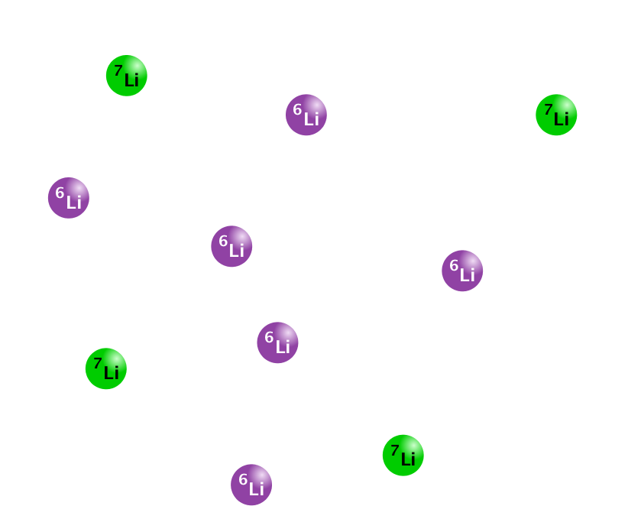
Sample 2
Equal to Sample 1
6.41548 amu average
Equal to Sample 1
6.41548 amu average
Notes:
For the follow-up discussion from the previous clicker Q.

Slide 12
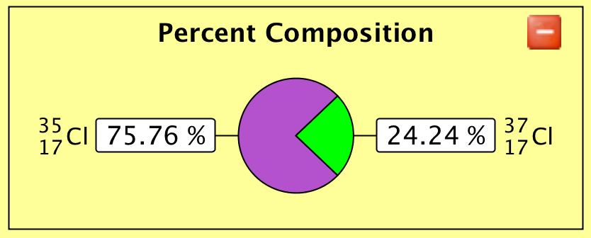
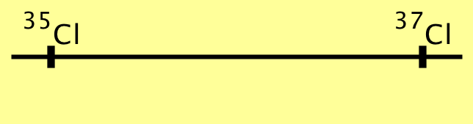
In nature, chlorine has the following composition:
The average atomic mass of a natural sample of chlorine is…
a
b
c
Between
35-36 amu
About
36 amu
Between
36-37 amu
Notes:
Sim directions: (optional) Show nature’s abundance of Cl using the sim with Average Atomic Mass hidden. Ask students to answer this question without consulting a periodic table.
Correct answer: A
Representative results from pre-general chemistry: 84% correct
Follow-up discussion: Ask students how they arrived at their estimate of the average atomic mass. Relate this back to the value indicated on the periodic table.

Slide 13
10
Ne
20.18
Neon has three naturally occurring isotopes:
²⁰Ne 19.992 amu
²¹Ne 20.994 amu
²²Ne 21.991 amu
Which isotope has the highest natural abundance?
²⁰Ne
²¹Ne
²²Ne
All isotopes have the same abundance
Impossible to tell from this information
Notes:
Goal: Connect the sim to the atomic mass values shown on the periodic table, as well as extending estimation skills to mixtures of 3 isotopes.
Correct answer: A
Representative results from pre-general chemistry: 75-77% correct when asked either during instruction or during a pre-exam review (incorrect answers were evenly distributed among other options)
Follow-up discussion: Use the sim to demo a mixture starting from an even ratio of all isotopes, then showing how the addition of more of each isotope would increase/decrease/not affect the average atomic mass

Slide 14
Magnesium has three naturally occurring isotopes:
²⁴Mg 23.985 amu
²⁵Mg 24.986 amu
²⁶Mg 25.983 amu
In a sample with an average atomic mass of 24.98 amu,
which isotope is the most abundant?
²⁴Mg
²⁵Mg
²⁶Mg
All isotopes have the same abundance
Impossible to tell from this information
Notes:
Correct answer: E
Representative results from pre-general chemistry: 74% chose option B. Only 6% chose the correct answer on first vote.
Follow-up class discussion: Use the sim to show that multiple different samples could produce this average, including…
A sample with equal abundance of all three isotopes
A sample containing only Mg-25
A sample with no Mg-25 and an equal abundance of Mg-24 and Mg-26
Emphasize that the only thing we know from this information is that there MUST be equal amounts of ²⁴Mg and ²⁶Mg, and contrast this with the previous question.
Another option for follow-up discussion would be to show one of these examples in the sim and ask students to determine one or more other examples by discussing with their neighbours.

Slide 15
10
Ne
20.18
Neon has three naturally occurring isotopes:
²⁰Ne
²¹Ne
²²Ne
Which isotope has the highest natural abundance?
Can we answer the question without being given the exact isotopic masses?
Yes
No
Notes:
Goal: (1) Connect the concepts of mass number and isotopic mass. (2) Begin thinking about problems at a meta-level, answering questions about what information is needed to solve a given problem.
Correct answer: A (Yes)
Representative results from pre-general chemistry: 61% Yes
Follow-up discussion: Ask students why – have them discuss the meaning of the number in the isotope symbol, and uncertainty/precision of values.

Slide 16
Neon has three naturally occurring isotopes:
²⁰Ne
²¹Ne
²²Ne
Which isotope has the highest abundance in a sample of Ne?
Can we answer the question without being given the average atomic mass of the sample?
Yes
No
Notes:
Goal: Ask students to think about problems at a meta-level, answering questions about what information is needed to solve a given problem.
Correct answer: B (No)
Representative results from pre-general chemistry: 81% No
Follow-up discussion: Ask why this is not solvable.

Slide 17
Neon has three naturally occurring isotopes:
²⁰Ne
²¹Ne
²²Ne
Which isotope has the highest abundance in a sample of Ne with average atomic mass of _________?
Can we answer the question for any sample, no matter what the average atomic mass?
Yes
No
Notes:
Goal: Ask students to think about problems at a meta-level, answering questions about what information is needed to solve a given problem.
Correct answer: B (No)
Representative results from pre-general chemistry: 71% no when asked as a pre-exam review
Follow-up discussion: Ask students for counterexamples – e.g. If the average mass is close to the middle isotope, we cannot be certain. Use the sim to build counterexample samples that have the same average mass.

Slide 18
Challenge problem:
Argon has three stable isotopes, with these atomic masses:
³⁶Ar 35.968 amu
³⁸Ar 37.963 amu
⁴⁰Ar 39.962 amu
You measure the average atomic mass of several different samples of argon, and are asked to predict the most abundant isotope in each sample.
For which of these samples is this prediction impossible?
Sample A, a naturally-occurring sample of argon
Sample B, average atomic mass = 36.5 amu
Sample C, average atomic mass = 37.5 amu
Sample D, average atomic mass = 39.5 amu
Notes:
Goal: Ask students to think about problems at a meta-level, answering questions about whether the information given is sufficient to solve a given problem.
Correct answer: C
Follow-up discussion: Use the simulation to show where the average atomic mass lies on a number line between 36 and 40 amu. Show how adding more of a given isotope affects the average atomic mass. Ask students what external resource they would use to find the average atomic mass of a ‘naturally occurring sample’ (i.e. periodic table).

Slide 19
Lithium
3
Li
6.941
Complete the following sentence with a unit.
On average, lithium weighs 6.941 ____.
g / atom
g / mol
amu / mol
amu / atom
More than one of the above
Notes:
Goal: Connect the numbers and units in simulation to the periodic table and common units used in chemistry. This question was asked as a review later in the semester, after students had been exposed to both average atomic mass (in this sim) and molar mass.
Correct answer: E (i.e. A and D)
Representative results from pre-general chemistry: 54% said E (next highest was 36% B).
Follow-up discussion: Ask students which answers they chose if they said E (if your clicker system allows for multiple response, you could ask them to select all that apply). Note that some of the students who choose E may think that 1 amu = 1 gram, and that B and C are both correct. Discuss the relative sizes of grams and amus. Optionally, discuss that both are defined units based on C-12, which is why 1 amu/atom = 1 g/mol.

