Slide 1
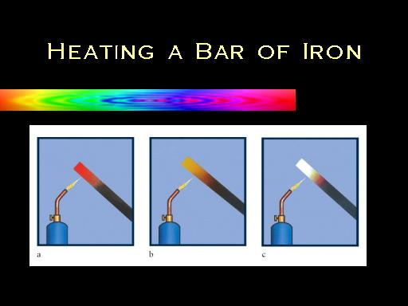
Can the color of a glowing object
tell us the temperature of the object?
Hot……... Hotter…..... Hottest!

Slide 2
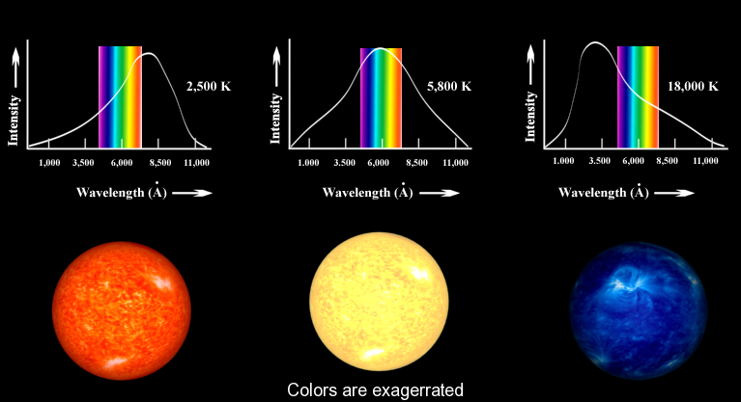
Blackbody Simulation Lab And Wien’s Displacement Law
NIS, Taldykorgan
Grade 11 Physics

Slide 3
Objectives:
To Use Wien’s Displacement Law to solve problems for estimating of black body radiation.
To collect, graph and analyze data, from a computer simulation, that allows the calculation of Wien’s constant.
To understand why Wien’s Law is the most important tool use by Astronomers to determine the temperature of a star.

Slide 4
Wien’s Law and Constant “b”
The Wien's Displacement Law state that the wavelength carrying the maximum energy is inversely proportional to the absolute temperature of a black body.
λ_{max}T = b
Where,
λ_{max} = Wavelength of maximum intensity ( meters ) T = Temperature of the blackbody ( kelvin ) b = Wien's displacement constant = 2.898 × 10⁶ nm·K
The precise value of ‘b’ is stated as 2.897 7721 x 10⁻³ m K with a standard uncertainty of +/- 0.000 0026 x 10⁻³ m K

Slide 5
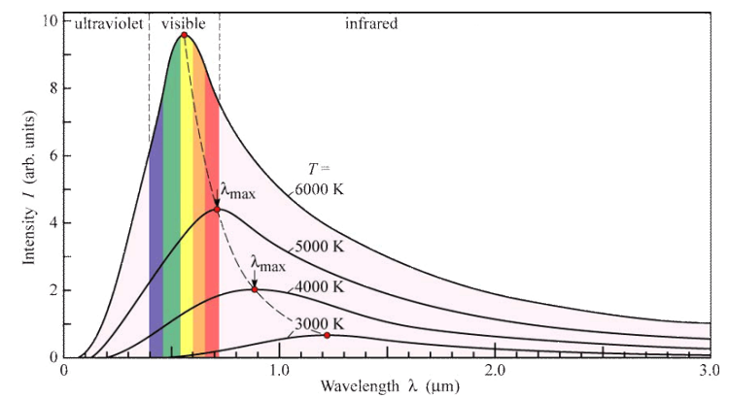
Wien’s displacement law with displacement line

Slide 6
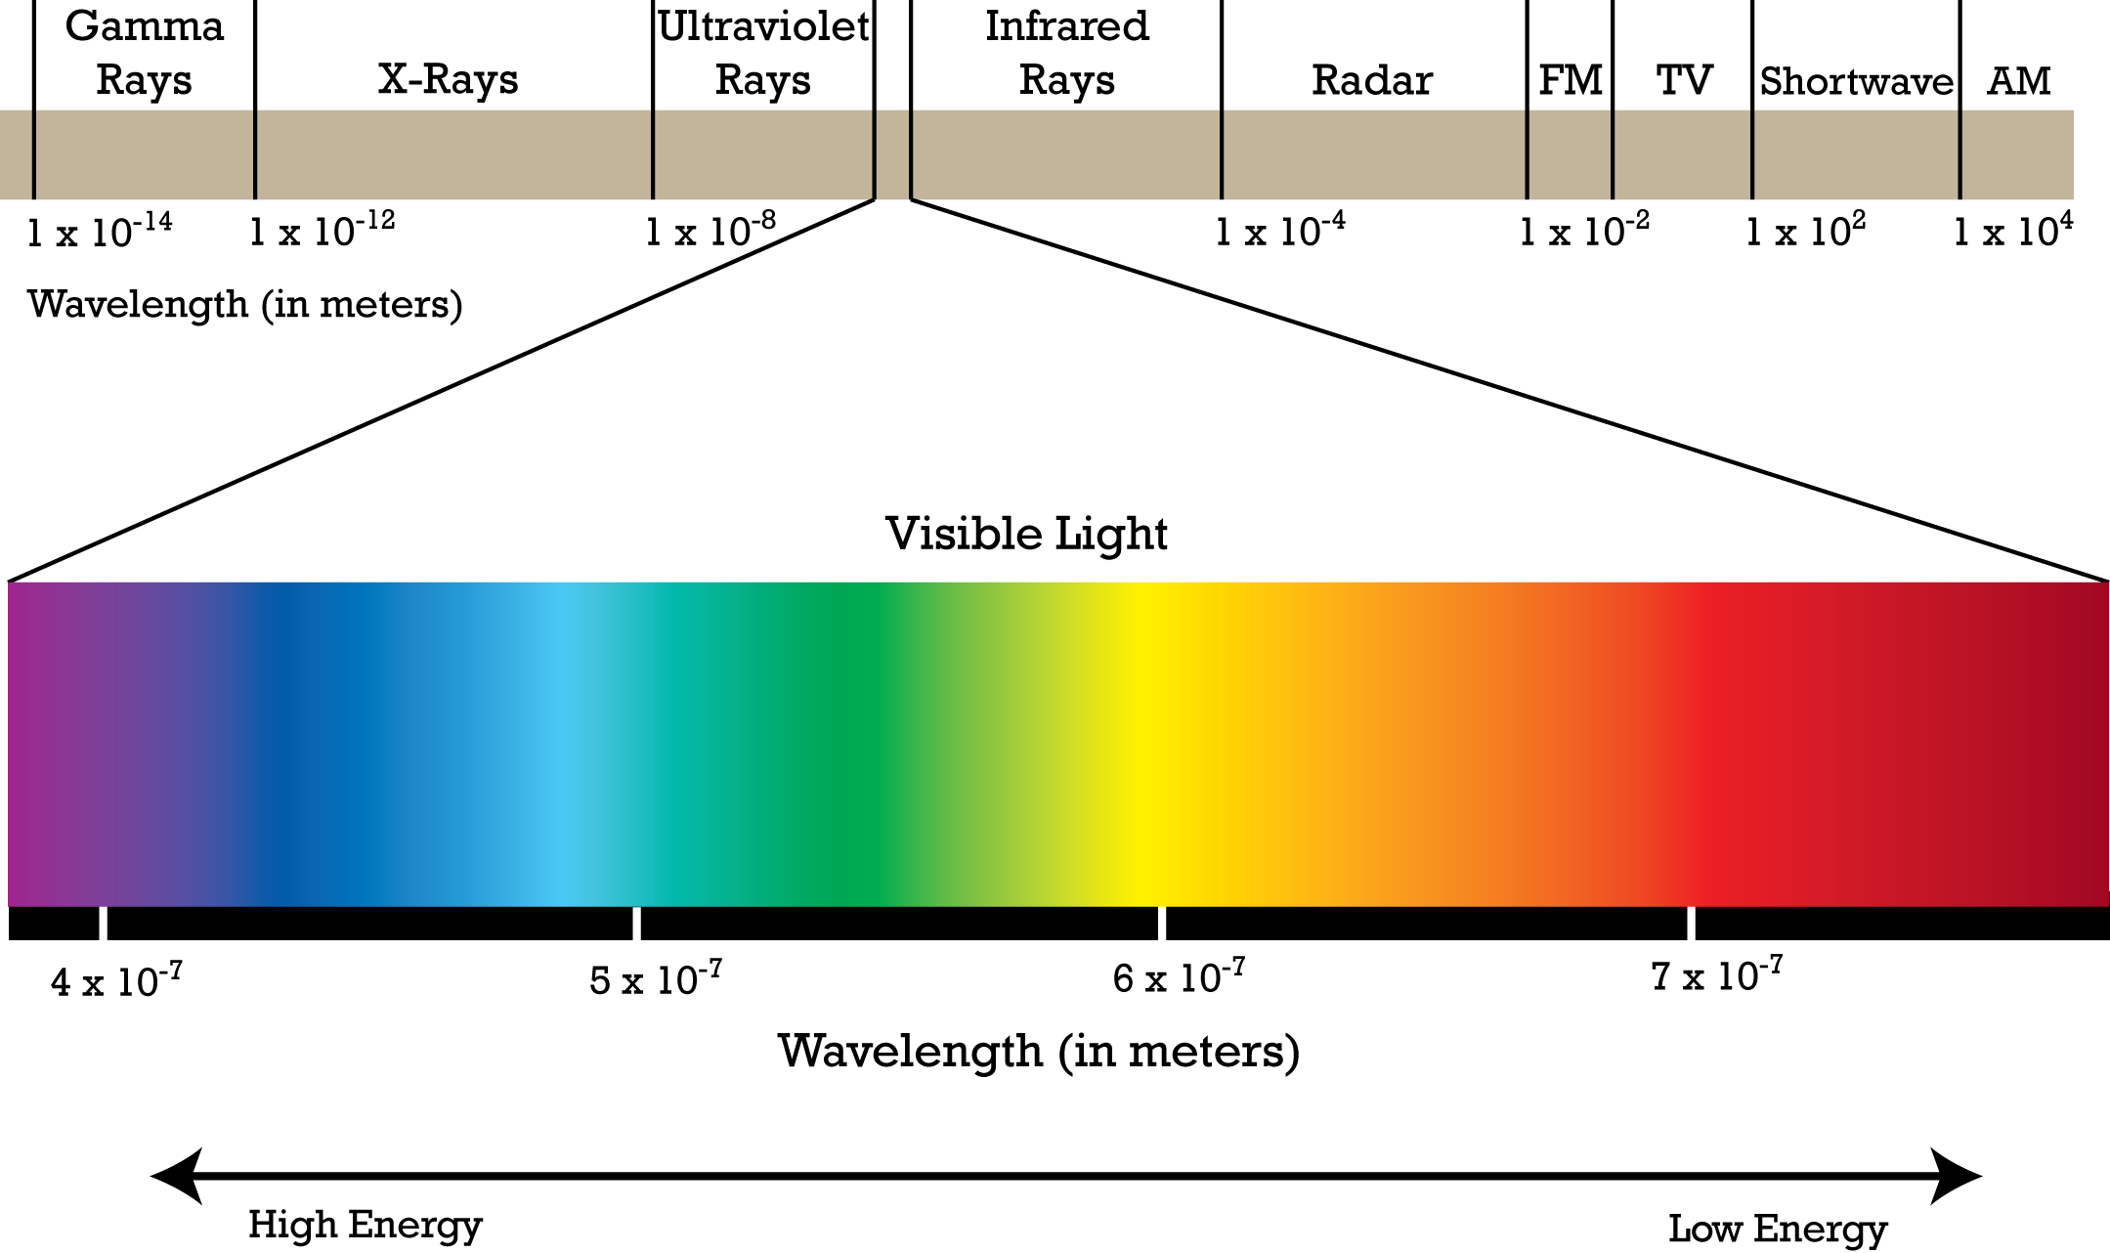
EM Spectrum in Meters

Slide 7
Vocabulary Terms of Astrophysics
Astronomy Term | Definition | Russian | Kazakh
Absolute Magnitude “M” | The apparent magnitude a star would have at 10 parsecs (32.6 light years) | Абсолютная величина "М"
Apparent Magnitude brightness “m” | Each division is 2.51 times brighter than the next magnitude, sun has m= -26 | Кажущаяся яркость Магнитуда "м"
Apparent Magnitude scale | A modern version of Hipparchus scale | Полная шкала Магнитуда
Intensity | Power per unit area at the observer: I=P/4πr² | интенсивность
Luminosity | Total power radiated by a star (joules/sec=watts), depends on the temperature and distance between the star and the observer. L≈ d²T⁴ | светимость
Parallax Angle | The shift, relative to the background, caused by a shift in the observer’s position. | Параллакс Угол
Parsec | The distance at which one AU subtends an angle of one arc second (1/3600th of a degree), 1 pc = 3.26 light years | парсек
Relative Brightness scale | A scale created by in 120 BC where 1 is the brightest star and 6 is the dimmest star | Относительная шкала Яркость
Spectral Class | A classification of a star based on features of its spectrum which also indicate its surface temperature and chemical composition | Спектральный класс
Wein’s Displacement Law | Defines a relationship between the peak radiation emitted by a star and its temperature. | Объем Закон Wein в

Slide 8
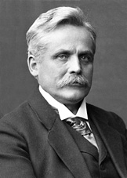
Wilhelm Wien, 1864-1928
Wilhelm Wien "led us to the very gates of quantum physics". Words of Max von Laue
Born in Prussia, son of landowner/farmer
Professor of Physics at University of Munich
First to define an ideal “blackbody”
Received Nobel Prize in Physics in 1911 for work on temperature and entropy of radiation
Reference: Wilhelm Wien – Biographical, from NoblePrize.org
http://www.nobelprize.org/nobel_prizes/physics/laureates/1911/wien-bio.html
Notes:
Wien’s work contributed greatly to the transition from Newtonian Physics to Quantum Physics! He discovered at the same time as JJ Thompson, by a different method that the electron was 2000 times lighter than hydrogen (a proton). ien's work enabled Max Planck to resolve the problem of radiation in thermal equilibrium by means of quantum physics. Wien's work enabled Max Planck to resolve the problem of radiation in thermal equilibrium by means of quantum physics.

Slide 9
EM Spectrum in Meters

Slide 10
References:
Wilhelm Wien – Biographical, from NoblePrize.org
http://www.nobelprize.org/nobel_prizes/physics/laureates/1911/wien-bio.html
Precise value of ‘b’:
http://physics.nist.gov/cgi-bin/cuu/Value?bwien
Star Colors and Temperatures
http://docs.kde.org/stable/en/kdeedu/kstars/ai-colorandtemp.html

