Slide 1
Alpha Decay Questions
Trish Loeblein 6/14/2011 http://phet.colorado.edu/
Learning Goals: Students will be able to:
Explain alpha decay process.
Explain what half-life means in terms of single particles and larger samples.
Lesson Plans and Activity

Slide 2
1. If you read a test question that says: Hg-202 undergoes alpha decay to Pt-198. What does that tell you?
A particle that has a mass of 4 is given off
A particle that has a mass of 4 is absorbed
“emitted” is another way to say “given off”

Slide 3

Hg-202 undergoes alpha decay to Pt-198.
2. What else do you know?
The particle emitted also has no charge
The particle emitted also has a charge of 2
The particle emitted also has a charge of 4
The particle emitted also has a charge of -2
Alpha particles are 2 protons and 2 neutrons represented as

Slide 4

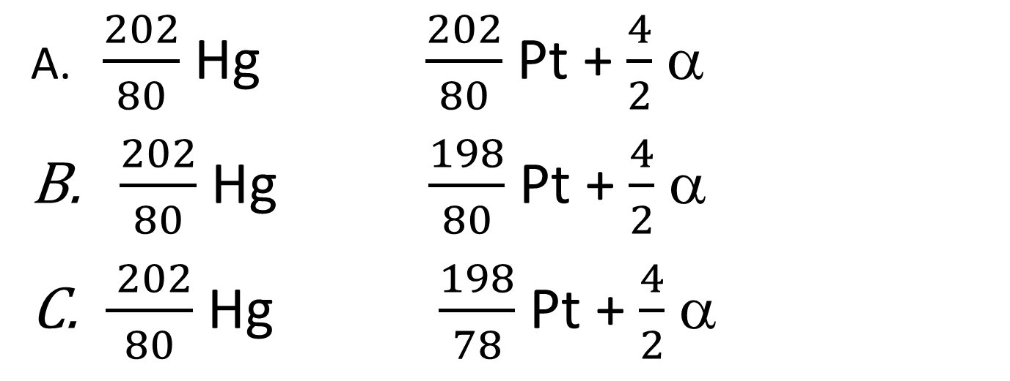
Hg-202 undergoes alpha decay to Pt-198.
3. What would the reaction look like?
$\frac{202}{80}$ Hg $\frac{202}{80}$ Pt + $\frac{4}{2}$ α
$\frac{202}{80}$ Hg $\frac{198}{80}$ Pt + $\frac{4}{2}$ α
$\frac{ 202}{80}$ Hg $\frac{198}{78}$ Pt + $\frac{4}{2}$ α
Remember mass and charge must be equal on both sides of reaction
Notes:
C

Slide 5
4. If you know the half-life of a substance is 50 seconds and the initial amount can be represented as which can you know for certain?
After 50 seconds the representation would be
After 50 seconds the representation could be
If the sample size is small, it could be very different after 50 seconds.
A and C
B and C
Notes:
E show on sim

Slide 6
5. If you know the half-life of a substance is 50 seconds and the initial amount can be represented as what would you predict the graph to look like after 150 seconds?
D nothing would be left
B
C
A
Notes:
C

