Slide 1
States of Matter Basics
Trish Loeblein
High School Chemistry lesson
January 2012
(this uses the simulation “Basics”, but the full version could be used)
For some questions, I turned on the Teacher menu item “ White background” because it works better with my projector.

Slide 2
Learning Goals:
Students will be able to:
Describe differences and similarities between solids, liquids and gases on a molecular level.
Explain gas pressure using the Kinetic Theory.
Determine processes you could use to make solids, liquids and gases change phases.
Compare and contrast the behavior of the 4 substances in the simulation and use your understanding about molecules to explain your observations.

Slide 3

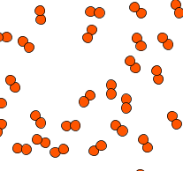

1. Which is most likely oxygen gas?
A B C
Notes:
C discussion how do you know?

Slide 4
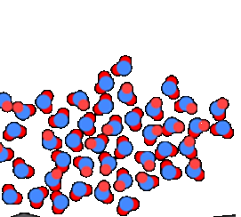
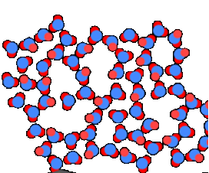
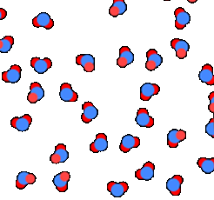
2. Which is most likely liquid water?
A B C
Notes:
discussion how do you know? A I am not sure that my students remember that water is less dense in solid form, but this would be a good time to remind them that ice floats.

Slide 5
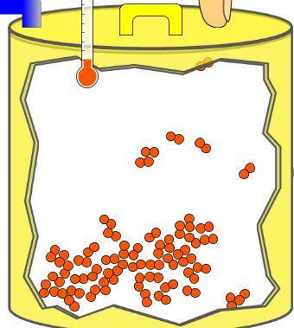
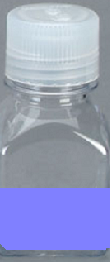
3. How could there be 2 phases of oxygen at one temperature?
Oxygen
Liquid-Gas
Like water-water vapor in a water bottle

Slide 6
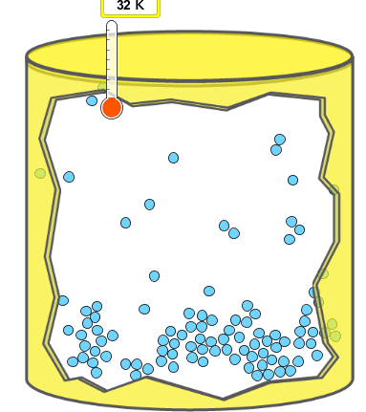
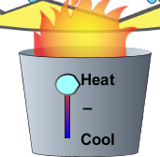
4. What happens if you add energy using the heater?
No change other than all atoms speed up
More atoms would condense
More atoms would vaporize
Notes:
C

Slide 7
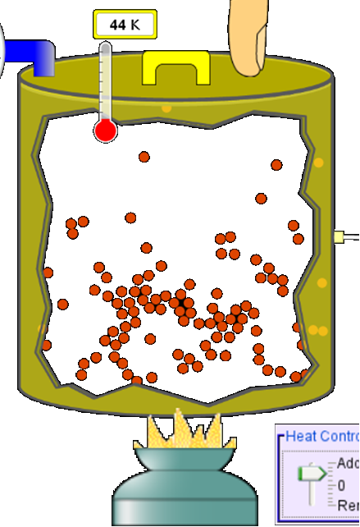
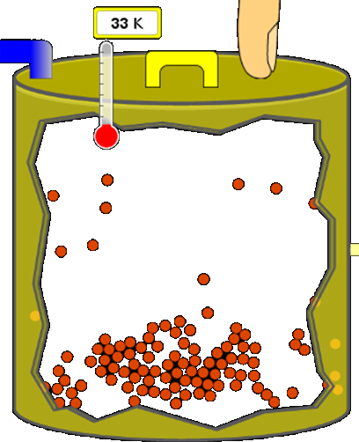
More are gaseous
Notes:
Demo this with the sim

Slide 8
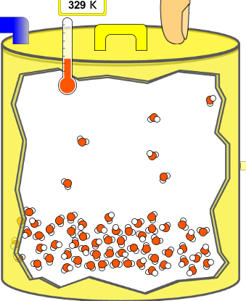
5. What happens if you reduce the volume?
No change other than the atoms would be closer together.
More atoms would condense
More atoms would evaporate
Notes:
B is the best answer, but discuss that the atoms in the gaseous phase might be closer together. Demo this with the sime

Slide 9
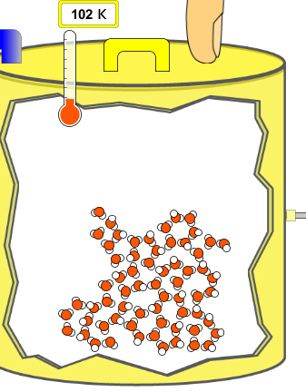
6. What happens if you reduce the volume a little?
No change
More atoms would condense
More atoms would evaporate
Notes:
A is the best answer, since this is a picture of solid water, vapor pressure is probably not significant to be affected by volume.

Slide 10



7. Which liquid material is most likely shown on the left?
Argon
Neon
Water
Oxygen
Temperature shown is the melting point.
Notes:
A argon would have a higher melting point because it has a greater mass which is the determining characteristic substances with just Van Der Waals forces. I used the

