Slide 1
Molecule Polarity
Learning Goals: Students will be able to:
Define bond polarity and molecular polarity
Explain the relationships between bond polarity and molecular polarity
Identify tools/representations to approximate bond and molecular polarity
  Use these common tools to approximate and compare polarity
Use standard notation to indicate polarity
Identify the bonds between atoms as nonpolar covalent, moderately polar covalent, very polar covalent, or ionic.
by Trish Loeblein updated October 2011

Slide 2
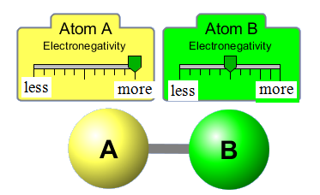
1. Which would represent the correct dipole?
There is no dipole
Notes:
B because the electronegativity is greater on atom A

Slide 3
2. Which would be the best description for the bond?
nonpolar covalent
moderately polar covalent
very polar covalent
ionic
Notes:
B because the electronegativity is greater on atom A, but not a great difference. Some students may chose C; this may be an acceptable answer since there are no values on the scales
(definitely not ionic since the sim is called “ Molecule Polarity” . Ionic compounds are not molecules.

Slide 4
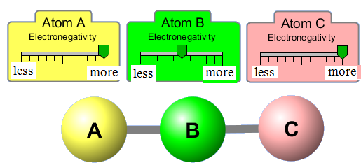
3. The molecule shown would be described with
polar bonds, nonpolar molecule
nonpolar bonds, nonpolar molecule
polar bonds, polar molecule
nonpolar bonds, polar molecule
Notes:
A
Make sure to ask :How did you decide?

Slide 5


4. The bond dipole and molecular dipole would be
, no molecule dipole
,
, no molecule dipole
,
Notes:
A
Make sure to ask :How did you decide?

Slide 6
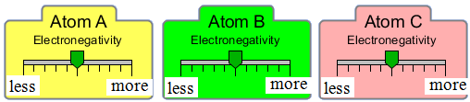
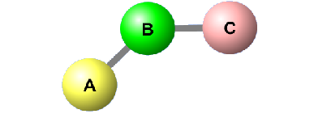
5. The molecule shown would be described with
polar bonds, nonpolar molecule
nonpolar bonds, nonpolar molecule
polar bonds, polar molecule
nonpolar bonds, polar molecule
Notes:
B
Make sure to ask :How did you decide? Draw the dipoles on your notes – There aren’t any

Slide 7
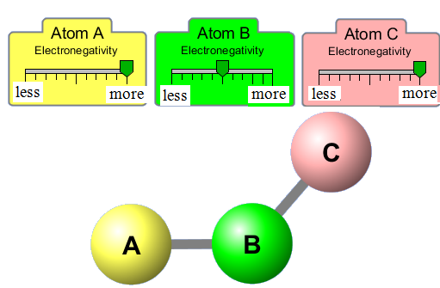
6. The molecule shown would be described with
polar bonds, nonpolar molecule
nonpolar bonds, nonpolar molecule
polar bonds, polar molecule
nonpolar bonds, polar molecule
Notes:
C
Make sure to ask :How did you decide?

Slide 8
7. Draw the dipole representations
Notes:
C
Make sure to ask :How did you decide?

Slide 9
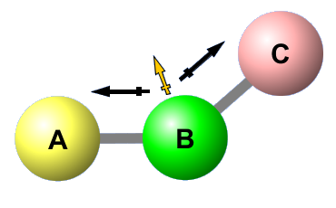
7ans. Draw the dipole representations
Notes:
Run the sim to demonstrate

