Slide 1
Sugar and Salt Solutions 1
Learning Goals: Students will be able to:
Identify if a compound is a salt or sugar by macroscopic observations or microscopic representations.
Explain how using combinations of solutes changes solution characteristics or not.
Use observations to explain ways concentration of a solute can change.
Describe ways the formula, macroscopic observations, or microscopic representations of a compound indicates if the bonding is ionic or covalent.
by Trish Loeblein updated October 2011

Slide 2
Which would you predict to be a salt?
CO₂
CaCl₂
C₁₂H₂₂O₁₁
HCl
Notes:
Make sure to ask :How did you decide?
B because it has a metal and non-metal

Slide 3
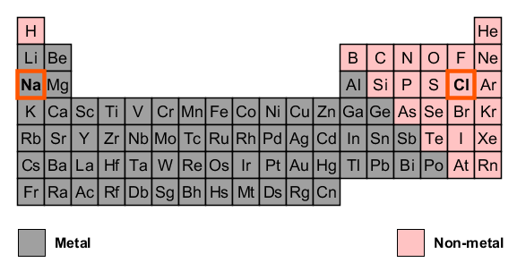
1. Ans Which would you predict to be a salt?
CO₂
CaCl₂
C₁₂H₂₂O₁₁
HCl
A metal combined with a non-metal make a “salt”.
Notes:
Make sure to ask :How did you decide?
B because it has a metal and non-metal

Slide 4

2. If a compound conducts electricity when in solution with water, you might categorize the compound as a
salt
sugar
Both conduct
Neither conduct
Notes:
A

Slide 5
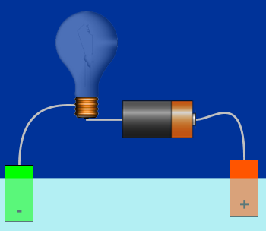
3. Which would not conduct electricity very well in solution with pure water?
O₂
CaCl₂
C₁₂H₂₂O₁₁
HCl
More than one of these
Notes:
E make sure to discuss, salts and acids conduct. Molecular substances like sugar and oxygen do not.

Slide 6
3ans. Which would not conduct electricity very well in solution with pure water?
Non-metals combined with each other don’t break into ions in solution. Ions are needed to conduct. Acids are an exception (compounds that begin with H); usually they break into ions.
O₂
CaCl₂
C₁₂H₂₂O₁₁
HCl
More than one of these
Notes:
E make sure to discuss, salts and acids conduct. Molecular substances like sugar and oxygen do not.

Slide 7



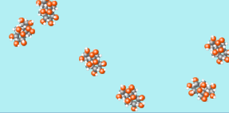
4. If the microscopic view of a compound in water looks like the picture on the left (I.), you might categorize the compound as a
I.
II.
Salt B. Sugar C. Neither
Notes:
Salt because it breaks apart.

Slide 8
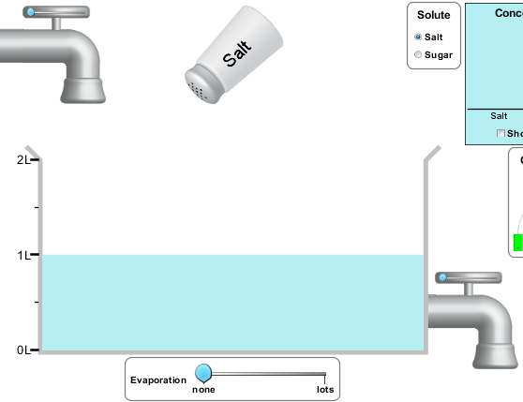
5. To increase the concentration of a solution, you could
Add more water
Add more salt
Evaporate
Drain out solution
More than one of these
Notes:
E. A and C

Slide 9
6. Which would you predict to be ionic?
NO
MgF₂
Al₂O₃
I₂
More than one of these
Notes:
Make sure to ask :How did you decide?
E (B and C) because they have a metal and non-metal

Slide 10
6ans. Which would you predict to be ionic?
NO
MgF₂
Al₂O₃
I₂
More than one of these
A metal combined with a non-metal make an “ionic compound”.
Notes:
Make sure to ask :How did you decide?
E (B and C) because they have a metal and non-metal

Slide 11
7. If the microscopic view of a compound in water looks like the picture on the left (I.), you might categorize the compound as a
I.
II.
Ionic B. Covalent C. Neither
7b What is the compound on the right (II.)?
Notes:
Ionic because it breaks apart. Some students might ask if it could be an acid; the answer is yes; so they
Covalent

Slide 12
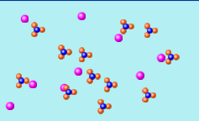

8. If the microscopic view of a compound in water looks like the picture, you might categorize the compound as
Ionic B. Covalent
7b How are the particles bonded?
Notes:
a. A ionic because it breaks apart.
b. Covalent because they don’t break apart.

Slide 13
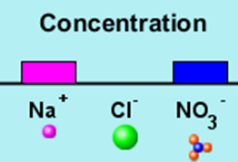
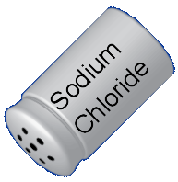
9. If Sodium Chloride is added to this solution, how will the concentrations change?
Only the Na⁺ will increase
Na⁺ and Cl⁻ will increase
NO₃⁻ will decrease
More than one of these
Notes:
B

