Slide 1
Resonance: upper division college
Clicker questions by Trish Loeblein and Mike Dubson
Learning Goals: Students will be able to:
Identify/explain the variables that affect the natural frequency of a mass-spring system.
Explain the distinction between transient and steady-state behavior in a driven system.
Identify which variables affect the duration of the transient behavior.
Recognize the phase relationship between the driving frequency and the natural frequency, especially how the phase is different above and below resonance.
Give examples the application of real-world systems to which the understanding of resonance should be applied and explain why.

Slide 2
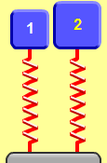
1. Which system will have the lower resonant frequency?
Mass (kg) | 2.5 | 5.0
Spring constant (N/m) | 100 | 100
Driver Amplitude (cm) | 2.0 | 4.0
A) 1 B) 2 C) Same frequency
Notes:
B because of the heavier mass. Some students may select C since the spring constants are equal. Use the sim to show the students. Amplitude is a distractor.

Slide 3
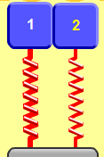
2. Which system will have the higher resonant frequency?
Mass (kg) | 5.0 | 5.0
Spring constant (N/m) | 200 | 100
Driver Amplitude (cm) | 2.0 | 4.0
A) 1 B) 2 C) Same frequency.
Notes:
A because of the higher spring constant. Some students may select C since the masses are equal. Use the sim to show the students. 1 has 1 Hz and 2 has 0.7 Hz

Slide 4
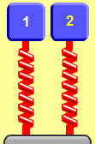
3. Which system will have the lower resonant frequency?
Mass (kg) | 3.0 | 3.0
Spring constant (N/m) | 400 | 400
Driver Amplitude (cm) | 0.5 | 1.5
A) 1 B) 2 C) Same frequency.
Notes:
C amplitude of the driver is an independent variable of frequency

Slide 5
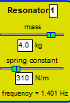



4. If the frequency f of the driver is not the same as the resonant frequency, which statement is most accurate?
The steady-state amplitude is ..
smallest at the highest driver f.
largest at the highest driver f.
is largest at driver f nearest the resonant frequency.
is independent of driver f.
Notes:
C

Slide 6
5. Transient behavior will last longer when
the damping constant is decreased.
the driving amplitude is increased.
Both of these.
None of these. The transient behavior is independent of the damping and the amplitude.
Notes:
Correct answer is A. Decay time for transient is independent of amplitude.

Slide 7
6. Two resonators are driven at the same driving frequency and amplitude. One resonator has a resonant frequency 2 Hz below the driving frequency. The other has a resonant frequency 2 Hz above the driving frequency.
Which resonator has the smallest steady-state amplitude?
The lower frequency resonator.
The higher frequency resonator.
Both have the same steady-state amplitude.
Notes:
Correct answer is A. Answer the question “experimentally” by using the sim.

