Slide 1
Resonance
Clicker questions by Trish Loeblein and Mike Dubson
Learning Goals: Students will be able to:
Describe what resonance means for a simple system of a mass on a spring.
Identify, through experimentation, cause and effect relationships that affect natural resonance of these systems.
Give examples of real-world systems to which the understanding of resonance should be applied and explain why. (not addressed in CQs)

Slide 2
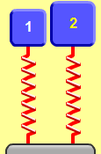
1. Which system will have the lower resonant frequency?
Mass (kg) | 2.5 | 5.0
Spring constant (N/m) | 100 | 100
A) 1 B) 2 C) Same frequency
Notes:
B because of the heavier mass. Some students may select C since the spring constants are equal. Use the sim to show the students.

Slide 3
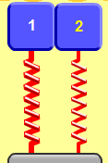
2. Which system will have the lower resonany frequency?
Mass (kg) | 5.0 | 5.0
Spring constant (N/m) | 200 | 100
A) 1 B) 2 C) Same frequency.
Notes:
B because of the lower spring constant. Some students may select C since the masses are equal. Use the sim to show the students. 1 has 1 hz and 2 has .7hz

Slide 4
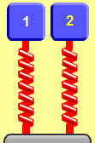
3. Which system will have the lower resonance frequency?
Mass (kg) | 3.0 | 3.0
Spring constant (N/m) | 400 | 400
Driver Amplitude (cm) | 0.5 | 1.5
A) 1 B) 2 C) Same frequency.
Notes:
C amplitude of the driver is an independent variable of frequency

Slide 5

4. Which best describes how the motion of the masses vary?
Less driver amplitude results in greater max height & faster oscillation
More driver amplitude results in greater max height & faster oscillation
Less driver amplitude results in greater max height
More driver amplitude results in greater max height
Mass (kg) | 3.0 | 3.0
Spring constant (N/m) | 400 | 400
Driver Amplitude (cm) | 0.5 | 1.5
Notes:
D amplitude of the driver is directly related to oscillation distance (A and B include another way to relate frequency; the frequency is not dependent on driver amplitude)

Slide 6
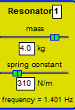



4. If the frequency f of the driver is not the same as the resonant frequency, which statement is most accurate?
The steady-state amplitude is ..
smallest at the highest driver f.
largest at the highest driver f.
is largest at driver f nearest the resonant frequency.
is independent of driver f.
Notes:
C

