Slide 1
Reactants, Products, and Leftovers
Activity 2: Limiting Reactants in Chemical reactions by Trish Loeblein http://phet.colorado.edu
(assuming complete reactions)
Learning Goals: Students will be able to:
Predict the amounts of products and leftovers after reaction using the concept of limiting reactant
Predict the initial amounts of reactants given the amount of products and leftovers using the concept of limiting reactant
Translate from symbolic (chemical formula) to molecular (pictorial) representations of matter
Explain how subscripts and coefficients are used to solve limiting reactant problems.
Notes:
July 2011

Slide 2
1. A mixture of 4 moles of H₂ and 3 moles of O₂ reacts to make water. Identify: limiting reactant, excess reactant, and how much is unreacted.
Limiting Excess
reactant reactant
H₂ 1 mole H₂
H₂ 1 mole O₂
O₂ 1 mole H₂
O₂ 1 mole O₂
No reaction occurs since the equation does not balance with 4 mole H₂ and 3 mole O₂
Notes:
B students will need to write the balanced chemical reaction or the teacher could provide it before showing the question.

Slide 3
2. A mixture of 6 moles of H₂ and 2 moles of O₂ reacts to make water. How much water is made?
6 moles water
2 moles water
3 moles water
4 moles water
No reaction occurs since the equation does not balance with 6 mole H₂ and 2 mole O₂
Notes:
D students will need to write the balanced chemical reaction or the teacher could provide it before showing the question.

Slide 4
3. A mixture of 2.5 moles of Na and 1.8 moles of Cl₂ reacts to make NaCl. Identify: limiting reactant, excess reactant, and how much is unreacted.
Limiting Excess
reactant reactant
Na .7 mole Na
Na .7 mole Cl₂
Na .55 mole Cl₂
Cl₂ .7 mole Na
Cl₂ 1 mole Na
Notes:
C
2.5 moles Na requires 1.25 moles of chlorine (diatomic) and 1.8 moles of chlorine would require 3.5 mole Na. So Na is the limiting reactant. 1.8-1.25 = .55 mole Chlorine

Slide 5
4. A mixture of 2.5 moles of Na and 1.8 moles of Cl₂ reacts to make NaCl. How much sodium chloride is made?
2.5 moles NaCl
1.8 moles NaCl
0.7 moles NaCl
0.55 moles NaCl
1 mole Nacl
Notes:
A
2.5 moles Na requires 1.25 moles of chlorine (diatomic) and 1.8 moles of chlorine would require 3.5 mole Na. So Na is the limiting reactant. The reaction is 2 Na + Cl2 = 2NaCl , so the moles of NaCl is equal to the moles of Na consumed

Slide 6

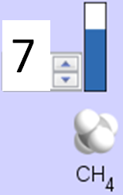
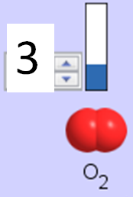
5. The reaction for combustion of methane is
Given the shown amounts for each reactant, predict the amounts of products and leftovers after complete reaction.
Notes:
Choices are on next slide

Slide 7
5. What are the amounts after the reaction?
Initial:
7 CH₄ and 3 O₂
After:
6 1 1 2
1 6 1 2
1 0 6 12
4 0 4 8
Notes:
A. use the sim to easily show this.

Slide 8

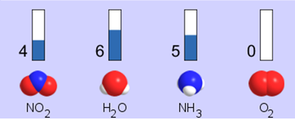
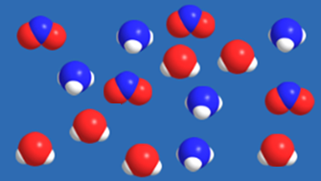




6. Given the shown amounts for the products and leftovers after a complete reaction, predict the initial reactants.
Notes:
Choices are on next slide

Slide 9




6. What are the amounts before the reaction?
After:
5 NH₃ 0 O₂ 4 NO₂ 6 H₂O
Before:
4 7
9 7
10 7
4 0
Notes:
B. This came from the game, so you would have to draw the reaction

Slide 10
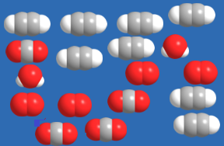


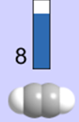





7. Given the shown amounts for the products and leftovers after a complete reaction, predict the initial reactants.
Notes:
Choices are on next slide

Slide 11


7. What are the amounts before the reaction?
After:
8 C₂H₂ 4 O₂ 4 CO₂ 2 H₂O
Before:
2 10
12 10
10 9
8 4
Notes:
C. This came from the game, so you would have to draw the reaction

Slide 12
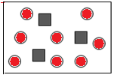

8. A mixture of S atoms ( ) and O₂ molecules ( ) in a closed container is represented by the diagrams:
Which equation best describes this reaction?
3X + 8Y → X₃Y₈
X₃ + Y₈ → 3XY₂ + 2Y
X + 2Y → XY₂
3X + 8Y → 3XY₂ + 2Y
X₃ + Y₈ → 3XY₂ + Y₂
From Lancaster/Perkins activity
Notes:
D

Slide 13

9. An initial mixture of sulfur( ) and oxygen( )is represented:
Using this equation: 2S + 3O₂ → 2SO₃ , what would the results look like?
From Lancaster/Perkins activity
Notes:
Answers on next slide. Give students some time before the answer selections are provided

Slide 14





9. Before: S O₂
2S + 3O₂ → 2SO₃
A B C D E
From Lancaster/Perkins activity
Notes:
D

Slide 15
10. Before: S O₂
2S + 3O₂ → 2SO₃
Which is the limiting reactant?
Sulfur
Oxygen
Neither they are both completely used
From Lancaster/Perkins activity
Notes:
B

