Slide 1
Build a Molecule activity by Trish Loeblein http://phet.colorado.edu/
Learning Goals: Students will be able to:
Review:
Describe the differences between an atom and a molecule.
Describe what the subscripts and coefficients indicate in chemistry notation.
Use proper chemistry nomenclature.
New:
Construct simple molecules from atoms.
Write rules for how atoms are arranged given formulas for some common molecules
Draw, name, and write formulas for some common molecules.

Slide 2
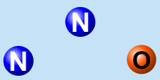

1. Which picture best displays atoms?
.
Both would be described as “atoms”
Both are better described as molecules
Notes:
A

Slide 3
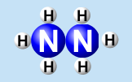
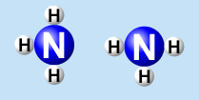
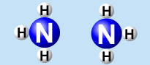
2. Which picture displays 2NH₃?
.
.
Two are correct
Notes:
D both B and C

Slide 4



3. Which could be hydrochloric acid?
.
.
Two are correct
Notes:
A only if in water solution…

Slide 5


4. Which could be CO₂?
.
Both are stable molecules
Notes:
B

Slide 6

5. What is the name of this molecule?
Methane
Tetrahydrogen carbide
Ammonia
Water
Notes:
A

Slide 7

6. What is the name of this molecule?
Dihydrogen oxide
Carbon dioxide
Ammonia
Water
Notes:
D

Slide 8

7. What is the name of this molecule?
Dichloride
Dichlorine
Chlorine
This is not a stable molecule
Notes:
C

