Slide 1
Balancing Chemical Equations Discussion and Clicker questions by Trish Loeblein 6/12/2011
Learning Goals: Students will be able to:
Describe what “reactants” and “products” in a chemical equation mean.
Explain the importance of knowing the difference between “coefficients” and “subscripts”.
Use pictures and calculations to show how the number of atoms for each product or reactant is found.
Identify the relationship between “reactants” and “products” atoms.
Balance a chemical equation using the relationships identified.
Given a chemical equation, draw molecular representations of the reaction and explain how the representations were derived.
Given a molecular drawing of a chemical reaction, write the equation and explain how the symbols were derived.

Slide 2





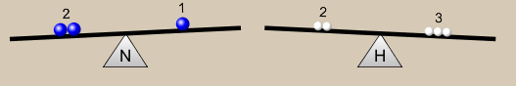
1. What would you do to balance this reaction?
Double the coefficient of N₂ (2 N₂ )
Multiply coefficient of H₂ by 3 (3 H₂ )
Multiply subscripts of H₂ by 3 ( H₆ )
Double the subscripts for NH₃ (N₂H₆)
Double the coefficient of NH₃ (2NH₃)
Notes:
This doesn’t have one answer. I would have the students discuss their ideas in pairs and then share out. The answers are B and E

Slide 3
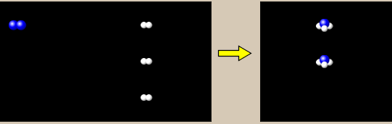
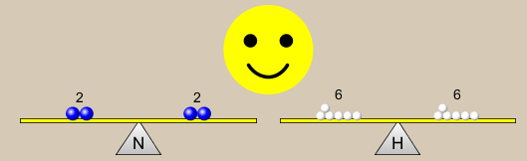



2. Which visual cues can you use on a test to see if your equation is balanced or not?
Notes:
Count atoms using chemical equation coefficients and subscripts
Smiley face and yellow equation sign (not available on test)
Use drawings of atoms/molecules
Make a balance picture
Make a bar graph

Slide 4







3. Which chemicals are reactants?
HN₃ and O₂
O₂ and H₂O
N₂ and H₂O
NH₃ and N₂
Notes:
A

Slide 5

4. Which best describes the products of a chemical equation?
Chemicals before the reaction starts
Chemicals after the reaction ends
Chemicals on the left of the arrow
Chemicals on the right of the arrow
Notes:
D I want to emphasize that chemical reactions are not complete nor immediate. Also, that “product” is a relative term which is determined by the author.

Slide 6





5. Which are the products of this chemical equation?
a
b
F₂ and H₂O
OF₂ and HF
More than 2 answers
Notes:
I would prefer C as the answer, but would accept E. I want to emphasize “product” is a relative term which is determined by the author, that the equation does not need to be balanced, and that the coefficients are not neessary.

Slide 7
Which best describes the products of a chemical equation?
An author of a test or text may chose to write this reaction:
Lesson learned: Don’t try to memorize reactions, analyze each one that is given.

Slide 8
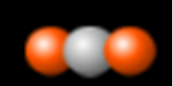




6. Is this reaction balanced?
Yes
No, there needs to be fewer red on the reactant side.
No, there needs to be more red on the product side.
No, for another reason.
Notes:
C, but one could argue that D is true because if you try to balance the red, more grey and white will be needed

