Slide 1
Isotopes and Atomic Mass: What does the mass on the periodic table mean? By Trish Loeblein http://phet.colorado.edu
Learning Goals:
Define “isotope” using mass number, atomic number, number of protons, neutrons and electrons
Compare and contrast: element, atom, isotope
Given the number of protons, neutrons and electrons, find the mass and name of an isotope
Given the name of an element and the number of neutrons, find the mass of an isotope
Give evidence to support or dispute: “In nature, the chance of finding one isotope of an element is the same for all elements.”
Find the average atomic mass of an element given the abundance and mass of its isotopes

Slide 2
Pre-Lesson Discussion
Calculate the average mass of the eggs in the container.
Record the mass of each type of egg and the number of each.
What is difference between the “Average Mass” and “Individual Mass”?
Design a situation to make the mixture ____g
Notes:
The teacher will need to figure out reasonable average mass for challenge.

Slide 3
Post-Lesson Questions

Slide 4

What would this be?
Carbon-12
Carbon-14
Oxygen-14
More than one of these
Notes:
B

Slide 5


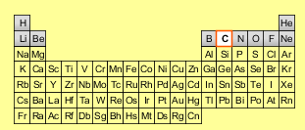
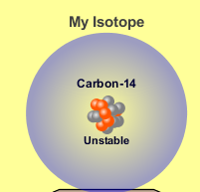
Reason: The number of protons tells the name of the atom; the mass is given by the sum of protons and neutrons
6 protons +8 neutrons = 14 amu

Slide 6



Which would be isotopes?
1 & 2
1 & 3
2 & 3
none
more than one combination
1
2
3
Notes:
A

Slide 7



Reason: Isotopes have same number of protons (so the same name), but different number of neutrons
1 and 2 are isotopes
1
2
3

Slide 8
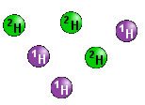
What would the approximate average mass of Hydrogen be?
6 amu
2 amu
1.5 amu
1 amu
Notes:
Answer is C :
A. 6 amu is the total mass B. one of the isotopes C. see next slide for reasoning D. most common isotope and value on periodic table.

Slide 9
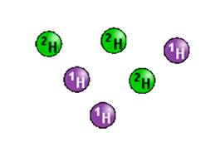
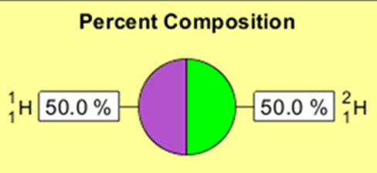
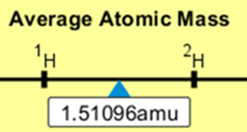
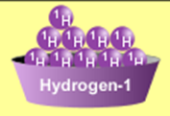
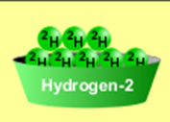
Reason: 3/6 gives 50% of each, so .5*2+.5*1=1.5 amu
Why are there more digits in the answer in the sim?
Notes:
You may discuss the fact that the isotope mass is rounded to whole numbers, but the exact values are
2.01410 and 1.00783. You can show this by using the sim. Just drag one isotope into the box and the value will be displayed.

Slide 10
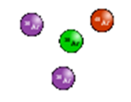
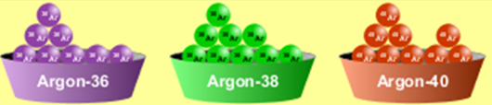
What would the approximate average mass of Argon be?
40 amu B. 38 amu C. 37.5 amu
Notes:
a. Value on periodic table b. just the middle value c. 37.5 = (2*36+38+ 40)/4 or .5*36+.25*38+.25*40

Slide 11
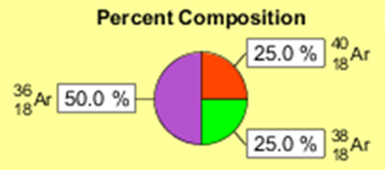
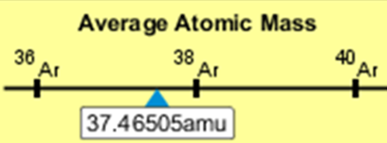
Reason: .5*36+.25*38+.25*40 =37.5

Slide 12
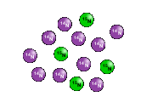


Discussion Questions: How would you know if this combination is likely to be found in some dirt?
Notes:
See next slide

Slide 13

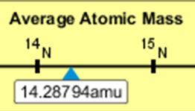

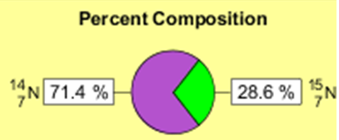
Reason: 10/14*14+4/14*15=14.285 On the periodic table, the mass of Nitrogen is given as 14.007, so this is not the most common mixture found in nature.
“My Mixture”
“Nature’s Mix”
Notes:
Students could use the sim to explain, but I want to emphasize use of the periodic table.

