Slide 1
Density Concept Question by Trish Loeblein used with Density Activity
Learning Goals:
Students will be able to use macroscopic evidence to:
Measure the volume of an object by observing the amount of fluid it displaces or can displace.
Provide evidence and reasoning for how objects of similar:
  mass can have differing volume
  volume can have differing mass.
Identify the unknown materials by calculating density using displacement of fluid techniques and reference tables provided in the simulation.
Notes:
I used these after the activity.

Slide 2
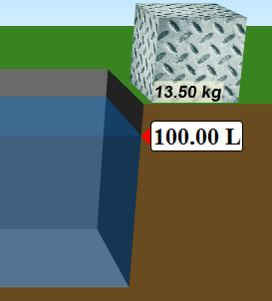
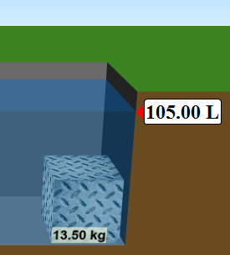
1. You put in a pool with 100 L of water. Then you drop an aluminum block in and the volume rises to 105 L. What is the volume of the block?
5L
105 L
Depends on block shape
Not enough information
Notes:
A.

Slide 3
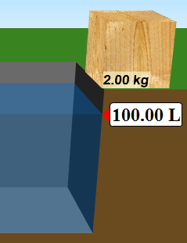
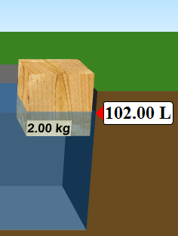
2. You put in a pool with 100 L of water. Then you drop an wood block in and the volume rises to 102 L. What is the volume of the block?
5L
105 L
Depends on block shape
Not enough information
Notes:
D because it is floating

Slide 4
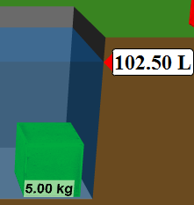
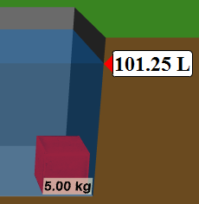
3. Two different blocks, both with a mass of 5 kg have different volumes. How is it possible?
One is more dense
They are made of the same material
They are made of different material
More than one of these
None of the above
Notes:
D both A and C

Slide 5
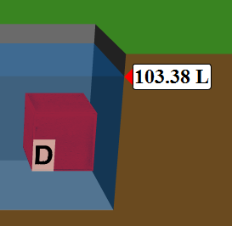
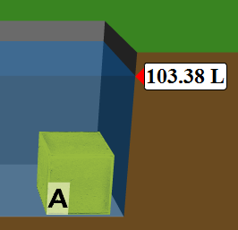
4. Two different blocks, both with a volume of 3.38L have different mass. What would be a good explanation?
A is more dense
D is more dense
A sinks
D floats
More than one of these
Notes:
A is the best answer. D is a true statement but not relevant.

Slide 6
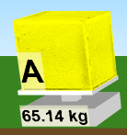
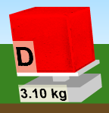


Some information for 4
Volume changes when submersed
Mass found using scale
It is true that D floats, but it is irrelevant to question. The important thing is that A is more dense – it’s mass is greater even though volume is the same.
Notes:
Go over vocabulary “submersed”

Slide 7
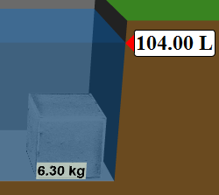
5. What is the density of the block?
0.63 L/kg
1.6 L/kg
0.63 kg/L
1.6 kg/L
Notes:
D is correct Distractors: a. wrong calc 4L/6.3 kg =.63 b. wrong units C. wrong calc and units

Slide 8
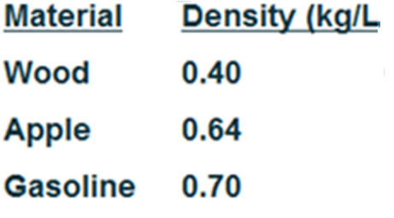

6. Joe was doing a lab. He massed an object and then pushed it into some water. He recorded- 3.5 kg and 5 L. What might the object be?
A.
B.
C.
D.
E.
Notes:
B 3.5/5 = .66 kg/L close to Apple

Slide 9
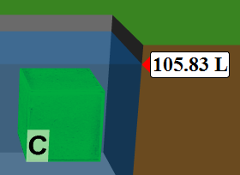
7. What is the mass of the block if it has a density of 0.86?
5.0 kg
91 kg
0.15 kg
6. kg
Notes:
a

