Slide 1
Gravity and Orbits Trish Loeblein: Two questions used to help my students review vector addition before we started vector addition in an Electrostatics units. They were very familiar with gravity problems. These were designed to illicit misconceptions. I think it could be used in many topics, but the teacher needs to emphasize that the vectors are not to scale.
Learning Goals- Students will be able to
Draw motion of planets, moons and satellites.
Draw diagrams to show how gravity is the force that controls the motion of our solar system.
Identify the variables that affect the strength of the gravity
Predict how motion would change if gravity was stronger or weaker.

Slide 2
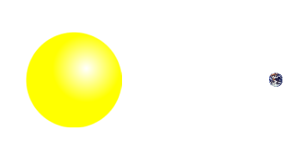
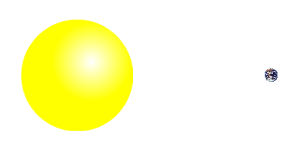
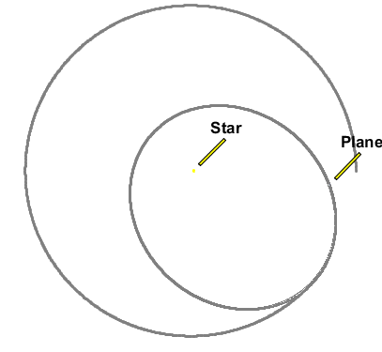
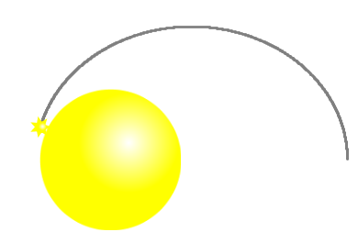
If our sun were twice as massive, how might the earth movement change?
The earth would definitely crash into the sun
B. The path would be smaller
C. The path would not change
Notes:
B. In the cartoon mode, the earth crashes into the sun, but in reality, the path is just reduced in size.

Slide 3
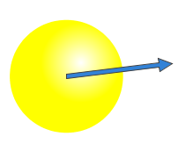
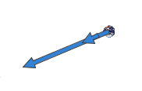
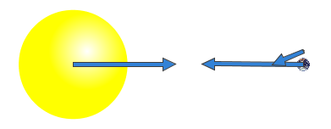
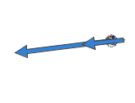
Which vector representation would show the moon between the earth and the sun? (black arrow Total Gravity Force on Moon)
B.
C.
Notes:
I used this to generate discussion about vector addition. The black arrow only shows the resultant vector acting on the moon. Most students chose A because the vector appears to be the smallest,. C shows the resultant translated to the left, so it could be reasonable also. The students asked how large the moon earth vector is because it is not viewable on the slide. That information would help identify if A or C were correct. I purposely hid the moon vector when I made this slide to help generate discussion. B would indicate that a fourth large body was present, or that the moon was not between the sun and earth, therefore is not correct.
These were all good ideas. See the next slide for more thoughts on using the sim to help this discussion.

Slide 4
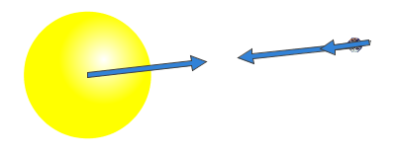
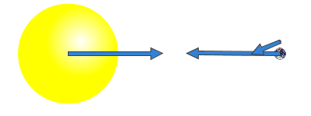
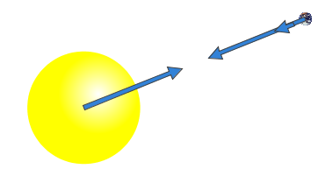
Use the simulation to show the path of the moon and the resulting vectors.
Reminder the placement of vectors in space is arbitrary. Translation of vectors doe not change the magnitude nor direction.
In the sim the resultant vector is not black, so you could ask if any of the vectors shown are the resultant force on the moon.
On this slide, the first and third image demonstrate that the location of the earth would not change the magnitude of the force vectors.
The second image shows the moon in a location not between the earth and sun.

