Slide 1
Ladybug Motion 2D
Learning Goals: Students will be able to draw motion vectors (position, velocity, or acceleration) for an object is moving while turning.
Open Ladybug Motion 2D and Ladybug Revolution before starting the questions.
Trish Loeblein July 2009 to see course syllabi :
http://jeffcoweb.jeffco.k12.co.us/high/evergreen/science/loeblein/phys_syl/syllabus_p.html

Slide 2


1. What could the position and velocity vectors look like?
A.
B.
C.
D.
Notes:
Remind the students that the flower represents the (0,0) location.
D is correct

Slide 3
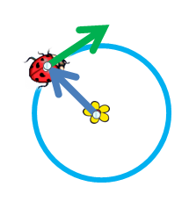
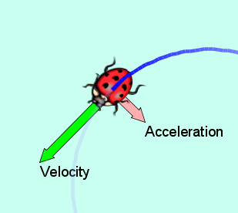
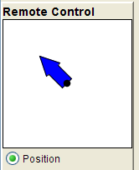
You could run the sim and discuss that in this situation the bug is traveling clockwise as opposed to counter clockwise in the sim. The velocity vector could be a different length depending on speed, but that the direction is correct.

Slide 4
2. What could the acceleration and velocity vectors look like?
A.
B.
C.
D.
Notes:
C is correct

Slide 5
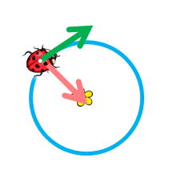
You could run the sim and discuss that in this situation the bug is traveling clockwise and that speed affects both velocity and acceleration vector length, but that the direction is correct.

Slide 6

3. What could the position & acceleration vectors look like?
A.
B.
C.
D.
Notes:
B is correct

Slide 7
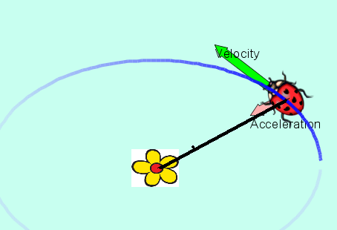
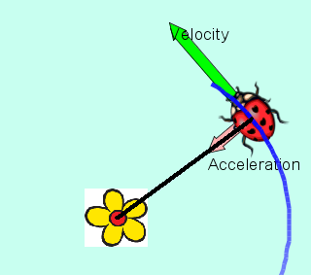
The acceleration would not be radial or the path would be circular. This is very difficult to see in the sim.

Slide 8
4. If you had two bugs moving in circles like this, what could the velocity vectors at point X vs point Y look like?
 | X | Y
A
B
C
D | Any of the above
E | None of the above are possible
X
Y
Notes:
D is correct, see next slide for possible discussion

Slide 9
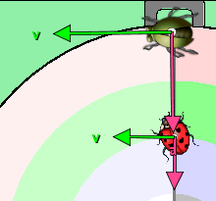
IF they were connected with a bar so they had to go around together, it would be like in Ladybug Revolution, but otherwise there is no way to know the length relationship, but the vectors would be parallel
X
Y

