Slide 1
pH Scale: qualitative learning goals
Determine if a solution is acidic or basic using
pH b) H₃O⁺/OH⁻ ratio molecular size representation c) Hydronium/Hydroxide concentration
Relate liquid color to pH.
Predict if dilution and volume will increase, decrease or not change the pH
Organize a list of liquids in terms of acid or base strength in relative order with supporting evidence.
Write the water equilibrium expression. Describe how the water equilibrium varies with pH.
Notes:
https://phet.colorado.edu/en/contributions/view/3183

Slide 2
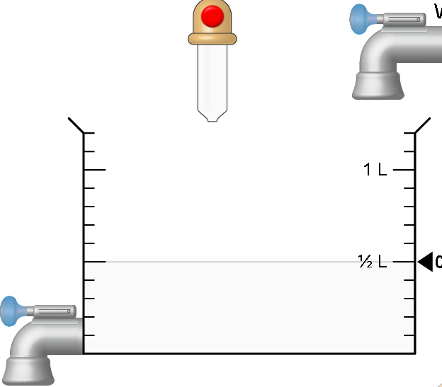
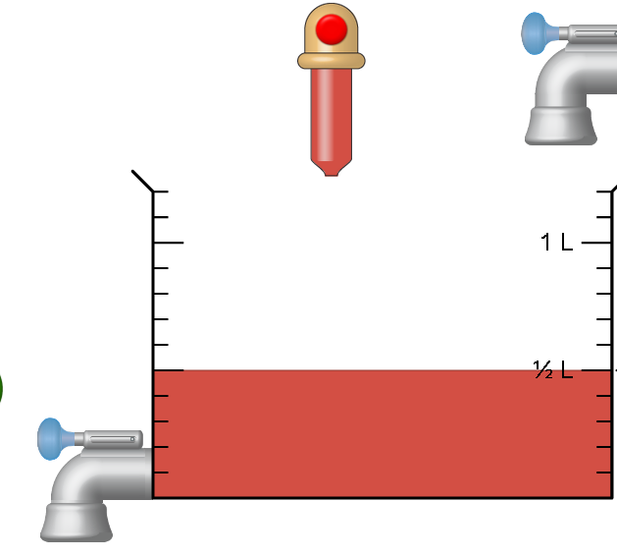
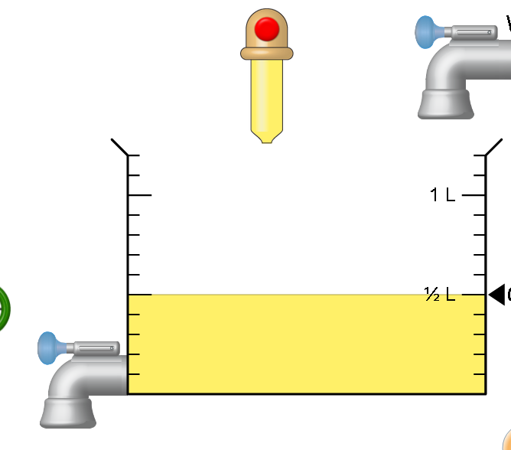
1. The color of a solution identifies if it is an acid, base, or neutral solution.
True B. False C. red is acid & clear is base
Notes:
B color of solution is not an identifying caharacteristic. Show sim: the left is milk, then blood, then a soup

Slide 3
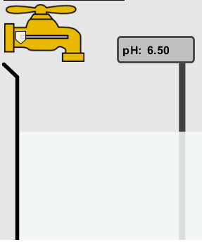
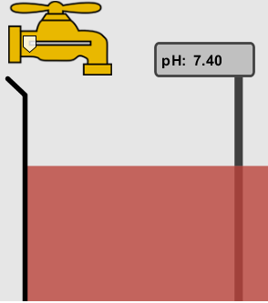
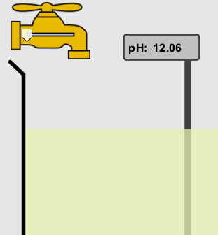
2. Which solution is basic?
A B C
D. More than one E. None
Notes:
Correct answer D (B and C) A milk, B blood C. custom at pH =12

Slide 4

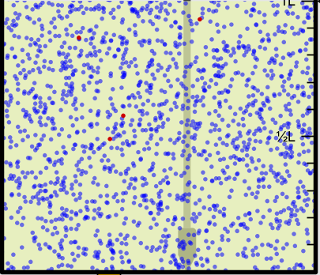
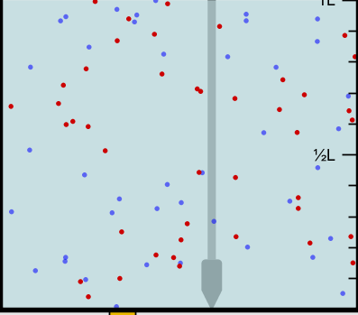
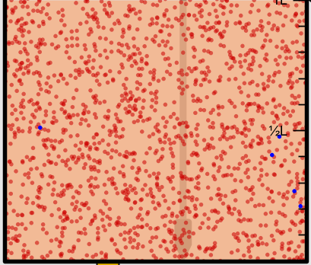
3. Which solution is acidic?
A B C
D. More than one E. Difficult to tell
Notes:
Correct answer is C, but they may argue E A. Custom pH =13 B. water pH =7 C. vomit pH=2

Slide 5
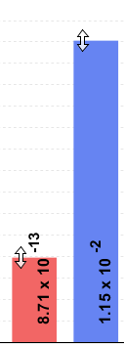
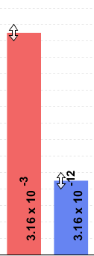
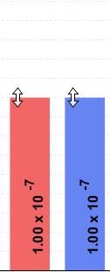
4. Which solution is basic?
A B C
D. More than one E. None
Notes:
This representation is not in the html5 sim
Correct answer B A. Water pH =7 B. pH =13 C. soda pop pH =2.5

Slide 6


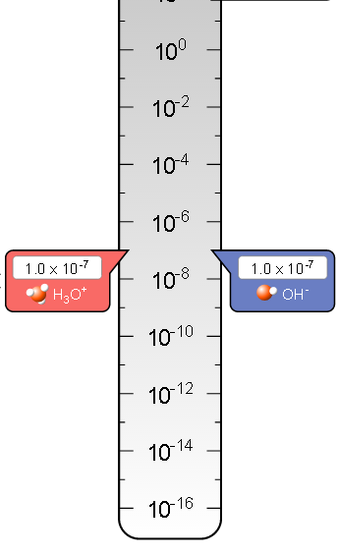
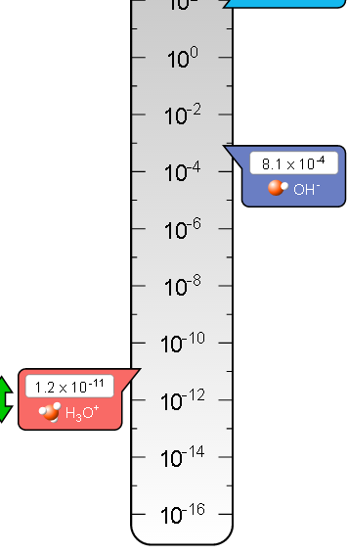
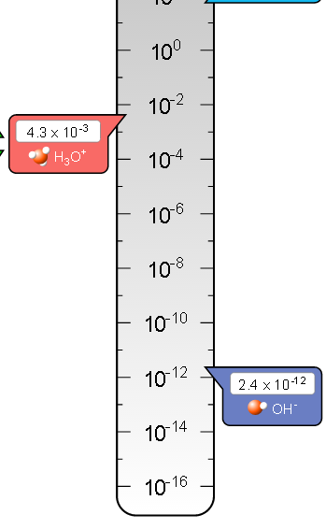
4. Which solution is basic?
A B C
D. More than one E. None
Notes:
This replaced the representation on the hidden slide #5 from the legacy sim
Correct answer B A. pH =7 B. pH =10.91 C. pH =2.37

Slide 7

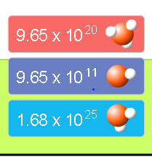
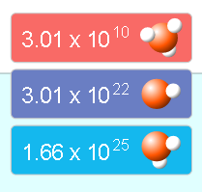
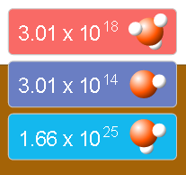
5. Which solution is acidic?
A B C
D. More than one E. None
Notes:
Correct answer D (A and B) A. Coffee pH =5 B. soda pop pH =2.5 C. custom pH =13,

Slide 8
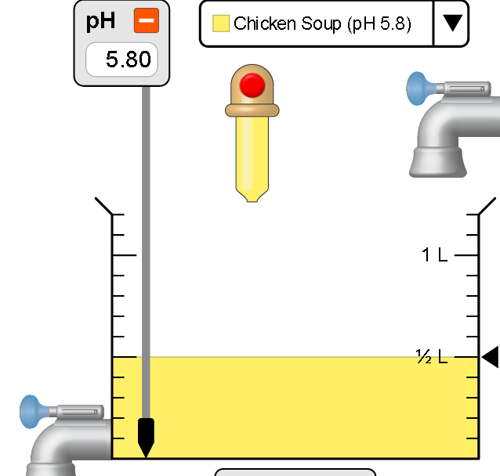
6. How will adding water effect the pH?
Increase the pH
Decrease the pH
No pH change
Notes:
A more water lessens the acidity, so pH goes up

Slide 9
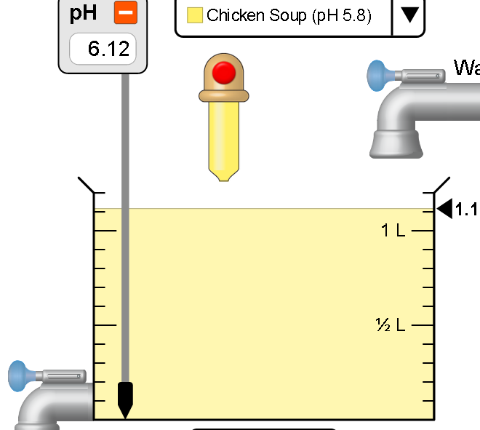
A: more water lessens the acidity, so pH goes up
Notes:
Use sim to show this

Slide 10
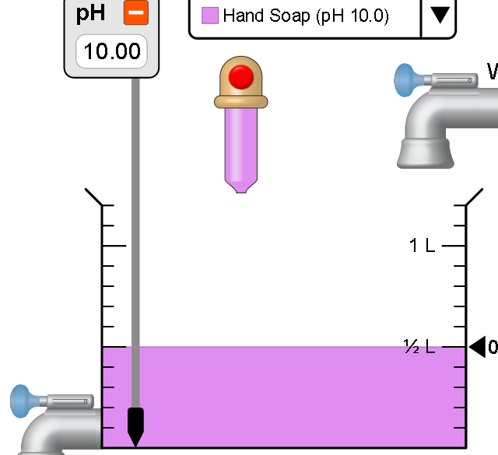
7. How will equal amount of water effect the pH?
Increase the pH
Decrease the pH
The pH will be cut in half
No pH change
Notes:
B: more water lessens the basicity , so pH goes down, but not by 2 (log scale)

Slide 11
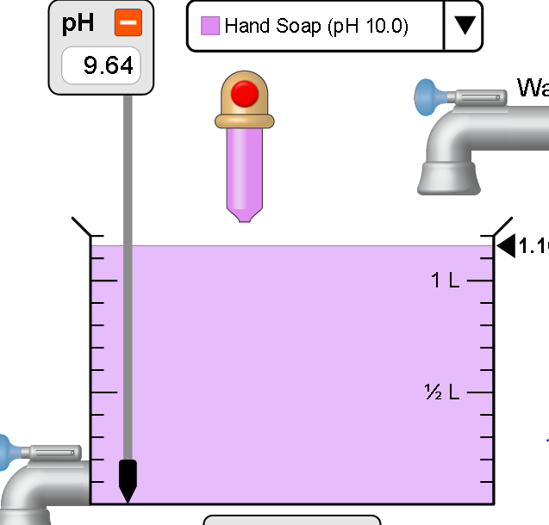
B: more water lessens the basicity , so pH goes down, from 10 to 9.7, but not by 2 (log scale)
Notes:
Use sim to show this

Slide 12
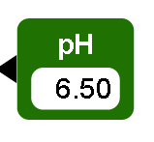
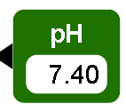
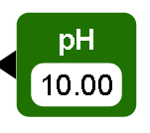
8. What is the order from most acidic to most basic?
A B C
A B C
A C B
B A C
C B A
C A B
Notes:
Correct answer is A A milk, B blood C. custom at pH =12

Slide 13
9. What is the order from most acidic to most basic?
A B C
A C B
B A C
C B A
C A B
A B C
Notes:
Correct answer C A. Water pH =7 B. pH =13 C. soda pop pH =2.5

Slide 14
10. If spit has a pH = 7.4, what does that tell you about the water equilibrium? 2H₂O ↔ OH⁻ + H₃O⁺
Something was added that made the equilibrium shift left
Something was added that made the equilibrium shift right
pH has nothing to do with the water equilibrium
Notes:
A

Slide 15
Answer to 10 Since the pH is not 7, then something was added to make the equilibrium shift left. For example, if NaOH was added to water, OH⁻ is immediately in the solution and some of it will react with the H₃O⁺ , so the pH (which is inversely related to [H₃O⁺ ]), goes up. If something like HCl were added there would be more H₃O⁺ , which would also cause a shift left, but there would be less OH⁻ , (which is directly related to pH), so the pH is less than 7.

