Slide 1
pH Scale: qualitative learning goals
Determine if a solution is acidic or basic using
    pH b) H₃O⁺/OH⁻ ratio molecular size representation c) Hydronium/Hydroxide concentration
Relate liquid color to pH.
Predict if dilution and volume will increase, decrease or not change the pH
Organize a list of liquids in terms of acid or base strength in relative order with supporting evidence.
Write the water equilibrium expression. Describe how the water equilibrium varies with pH.

Slide 2
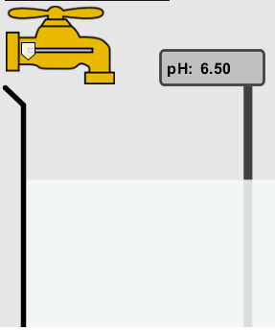
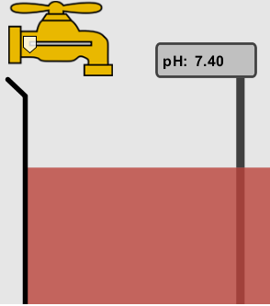
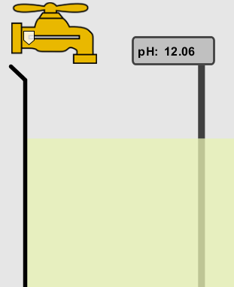
1. The color of a solution identifies if it is an acid, base, or neutral solution.
True B. False C. Pink are base and clear are acid
Notes:
B Show sim: the left is milk, then blood, then a custom liquid like NaOH

Slide 3
2. Which solution is basic?
A B C
D. More than one E. None
Notes:
Correct answer D (B and C) A milk, B blood C. custom at pH =12

Slide 4

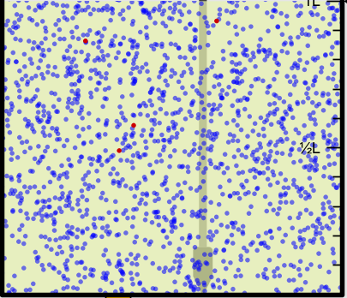
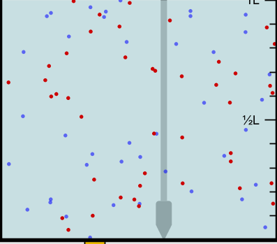
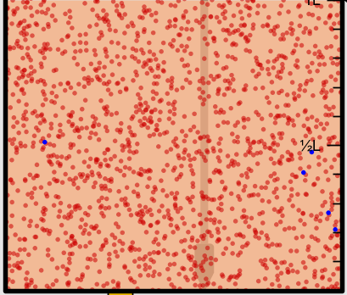
3. Which solution is acidic?
A B C
D. More than one E. Difficult to tell
Notes:
Correct answer is C, but they may argue E A. Custom pH =13 B. water pH =7 C. vomit pH=2

Slide 5
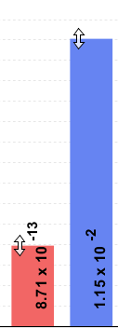
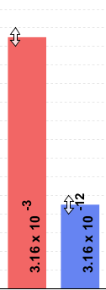
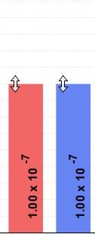
4. Which solution is basic?
A B C
D. More than one E. None
Notes:
Correct answer B A. Water pH =7 B. pH =13 C. soda pop pH =2.5

Slide 6

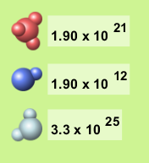
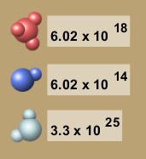
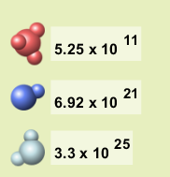
5. Which solution is acidic?
A B C
D. More than one E. None
Notes:
Correct answer D (A and B) A. Coffee pH =5 B. soda pop pH =2.5 C. custom pH =13,

Slide 7
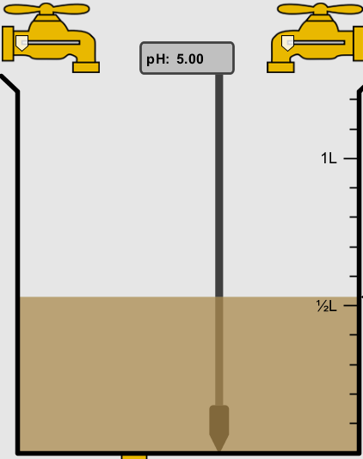
6. How will adding water effect the pH?
Increase the pH
Decrease the pH
No pH change
Notes:
A more water lessens the acidity, so pH goes up

Slide 8
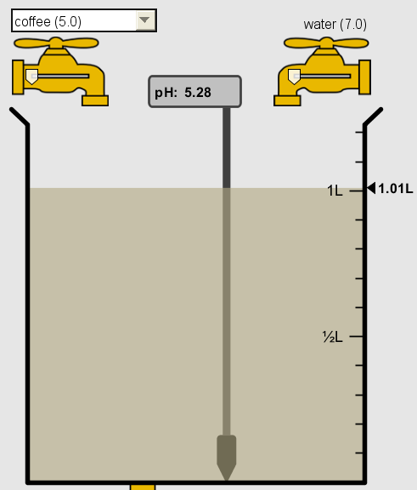
A: more water lessens the acidity, so pH goes up

Slide 9
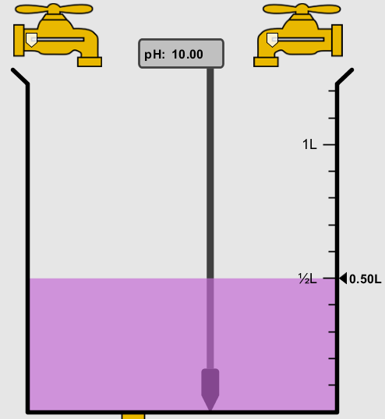
7. How will equal amount of water effect the pH?
Increase the pH
Decrease the pH
The pH will be cut in half
No pH change
Notes:
B: more water lessens the basicity , so pH goes down, but not by 2 (log scale)

Slide 10
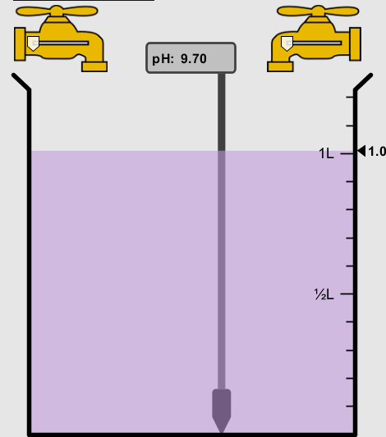
B: more water lessens the basicity , so pH goes down, from 10 to 9.7, but not by 2 (log scale)

Slide 11
8. What is the order from most acidic to most basic?
A B C
A B C
A C B
B A C
C B A
C A B
Notes:
Correct answer is A A milk, B blood C. custom at pH =12

Slide 12
9. What is the order from most acidic to most basic?
A B C
A C B
B A C
C B A
C A B
A B C
Notes:
Correct answer C A. Water pH =7 B. pH =13 C. soda pop pH =2.5

Slide 13
10. If spit has a pH = 7.4, what does that tell you about the water equilibrium?
2H₂O ↔ OH⁻ + H₃O⁺
Something was added that made the equilibrium shift left
Something was added that made the equilibrium shift right
pH has nothing to do with the water equilibrium
Notes:
A

Slide 14
Answer to 10
Since the pH is not 7, then something was added to make the equilibrium shift left. For example, if NaOH was added to water, OH⁻ is immediately in the solution and some of it will react with the H₃O⁺ , so the pH (which is inversely related to [H₃O⁺ ]), goes up.
If something like HCl were added there would be more H₃O⁺ , which would also cause a shift left, but there would be less OH⁻ , (which is directly related to pH), so the pH is less than 7.

