Slide 1
Reactions and Rates 1
Clicker Questions
Activity 1:
Introduction to reactions
Trish Loeblein
PhET Activity

Slide 2
Learning Goals
Students will be able to:
Describe reactions in terms of a simple molecular model.
Describe reactions in terms of molecular models with illustrations.
Differentiate between dissolving and reacting
Use the molecular model to explain why reactions are not instantaneous.
Use the molecular model to explain why reactions have less than 100% yields.

Slide 3
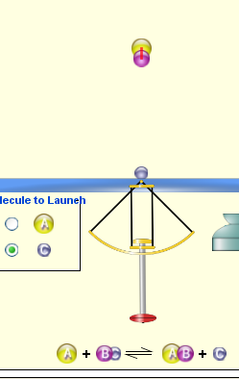


What will probably immediately happen ?
A
B
C
will form
will form
No reaction
Notes:
B

Slide 4
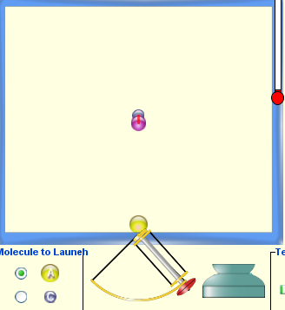
What will probably happen ?
A
B
C
will form
will form
No reaction
Notes:
C not correct angle and no energy

Slide 5
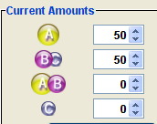
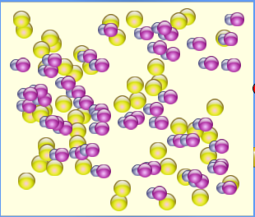
What will probably immediately happen ?
A
B
C
will form
will form
No reaction
Notes:
A

Slide 6
What will most likely be in the container after several minutes have passed ?
Container will have only &
Container will have only &
Container will have a mixture of all four
Notes:
C reactions are reversible

