Slide 1
Reactions and Rates 3 Clicker Questions
Activity 3:
Introduction to Equilibrium
Trish Loeblein
PhET
Notes:
Reactions and Rates activity 1 was done in September, #2 was done in December, 3 and 4 will be done in the same unit in March.

Slide 2
Learning Goals
Students will be able to:
Use a physical experiment to model chemical equilibrium
Sketch how the number of reactants and products will change as a reaction proceeds
Predict how changing the initial conditions will affect the equilibrium amounts of reactants and products.
Predict how the shape of the reaction coordinate will affect the equilibrium amounts of reactants and products.
Notes:
These are the questions that the students were asked about the sim.
How do you know when equilibrium has been reached?
How does changing the initial amounts of the reactants affect the amount of product?
How does changing the initial temperature of the reactants affect the amount of product?
Then they were asked to test another reaction and we had a share.

Slide 3
Which best shows that equilibrium has been reached?
A
B
Amount of substance vs time
Reaction Rates vs time
Amount
Rate
time
time
-Product -Reactants
-Forward -Reverse
Notes:
A see next slide for correct Rate graph

Slide 4
Correct rate graph Forward reaction rate =Reverse rate
Reaction Rates vs time
Rate
-Forward -Reverse
time

Slide 5
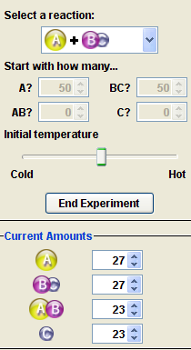
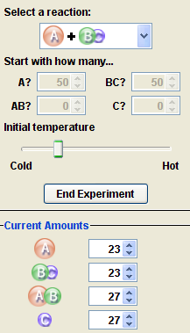
Which could show that equilibrium has been reached?
C neither
D either
A
B
Notes:
C or D need more information like time graph

Slide 6
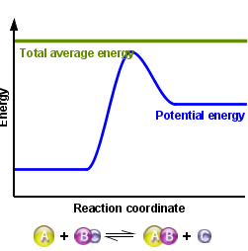
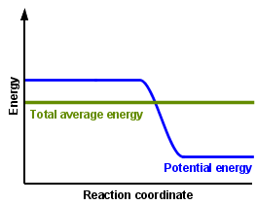
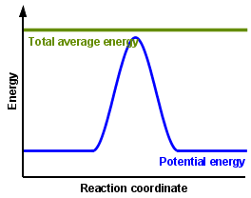
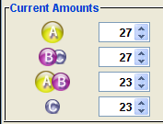
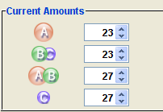
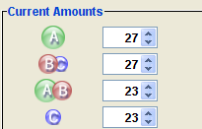
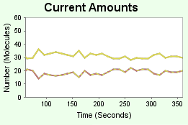
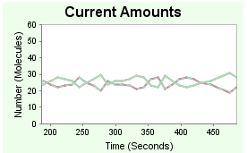
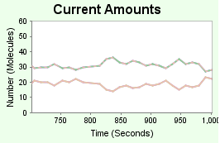
All are at equilibrium within limits

Slide 7
Which best shows that equilibrium has been reached?
The number of reactants is greater than the products
The number of products is greater than the reactants
The number of products is equal to the reactants
The number of products varies little
Notes:
D

Slide 8

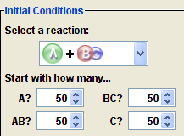
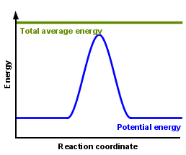
At equilibrium, what would you predict is in the container?
Notes:
Answer choices on next slide

Slide 9





Answer choices
Container will have mostly &
Container will have mostly &
Container will have a mixture of all four with nearly equal amounts
No reaction will occur since the products and reactants have the same energy
Notes:
C

Slide 10
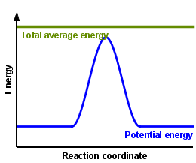
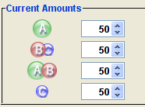
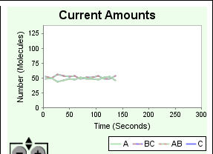
data

Slide 11
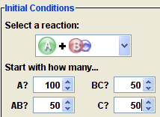
How will the equilibrium of second trial compare to the equilibrium of the first?
First experiment
Second experiment
Notes:
Answer choices on next slide

Slide 12

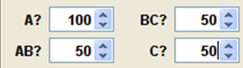
Answer choices
First trial
Second trial
There will be more &
There will be more &
There will be more & &
There will be more & &
The ratios will still be about the same
Notes:
C see next slide

Slide 13
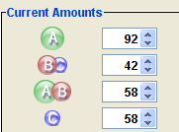
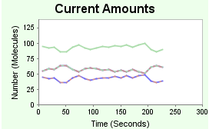
Data for reactions

Slide 14

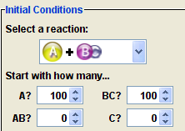
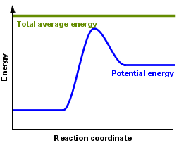
At equilibrium, what would you predict is in the container?
Notes:
Answer choices on next slide

Slide 15
Answer choices
Container will have only &
Container will have only &
Container will have a mixture of all four with more &
Container will have a mixture of all four with more &
Notes:
D because they have lower potential energy

Slide 16
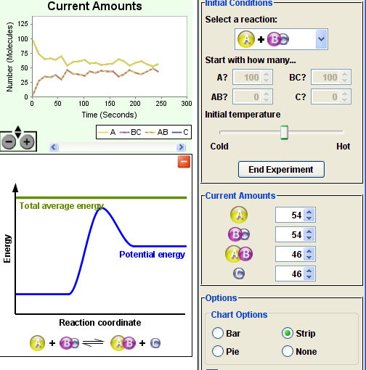
data

