Slide 1
Concept Questions for Balloons and Static Electricity and John Travoltage http://www.colorado.edu/physics/phet
Learning Goals: Students will be able to describe and draw models for common static electricity concepts. (transfer of charge, induction, attraction, repulsion, and grounding)

Slide 2
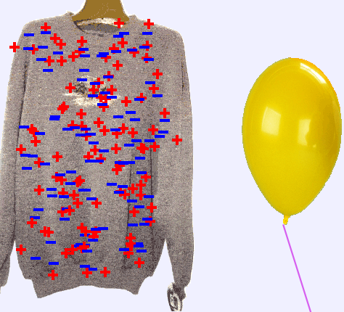
1. When the balloon is rubbed on the sweater, what might happen?

Slide 3
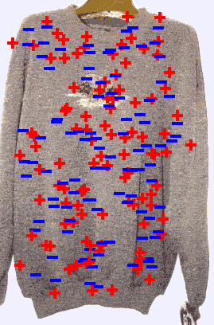


1. When the balloon is rubbed on the sweater, what might happen?
A. Some positive charges in the sweater will move onto the balloon
B. Some negative charges in the sweater will move onto the balloon
Notes:
B Only the electrons can transfer. The positive charges are protons which cannot move.

Slide 4

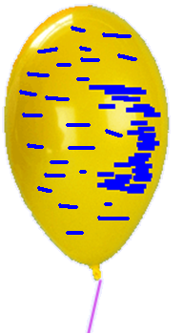
2. What do you think will happen when the balloon is moved closer to the wall?
Negatively charged balloon
Neutral wall

Slide 5

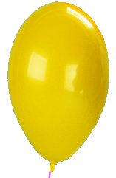

2. What do you think will happen when the balloon is moved closer to the wall?
Some positive charges in the wall will move towards the balloon
Some negative charges in the wall will move towards the balloon
Some positive charges in the wall will go onto the balloon
Some negative charges on the balloon will go to the wall
Notes:
A induction causes the electrons to move away. The positive charges are protons which cannot move.

Slide 6
3. What do you think the balloons will do?
Negatively charged balloon
Negatively charged balloon

Slide 7
3. What do you think the balloons will do?
The balloons will move towards each other
B. The balloons will move away from each other
C. The balloons will not move.
Notes:
B. The negative charged bodies will repel one another.

Slide 8
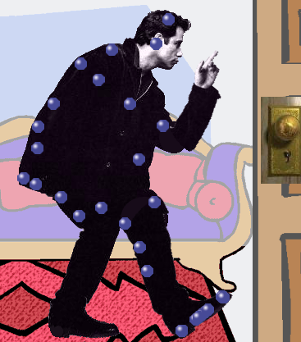
4. What might happen to the charge on the man when he touches the door knob?

Slide 9
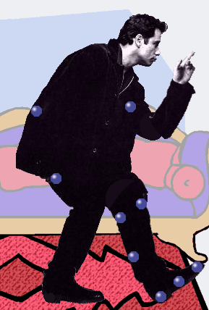
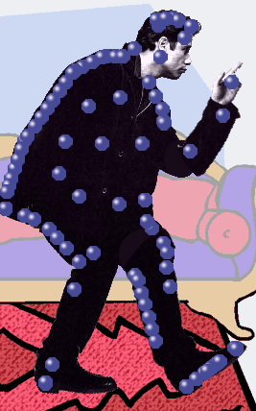
4. What might happen to the charge on the man when he touches the door knob?
Most electrons will go into the knob and down to the earth.
B. Some electrons will go from the earth through the knob and into the man.
Notes:
A. Some electrons will go into the earth

