Slide 1
Gas Properties Review
Describe image of gases using words and diagrams
How gases are distinguishable from a solid or liquid
How the particle mass and gas temperature affect the image.
How the size and speed of gas molecules relate to everyday objects
See also “Physics Topics for Gases handout”

Slide 2
Gas Properties: Understanding gas model
Goals: Describe a molecular model of gas pressure.

Slide 3
1. There are 2 balloons in a room. They are identical in size and material. One balloon is filled with air and the other balloon is filled with Helium. How does the pressure of the air balloon compare to the pressure of the Helium balloon. The pressure in the air balloon is
A. less B. equal C. greater
Notes:
b

Slide 4

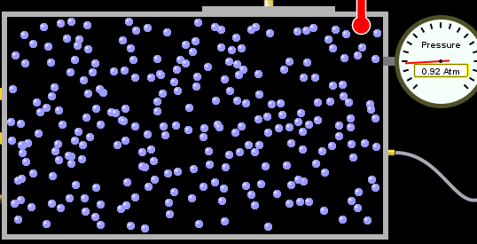
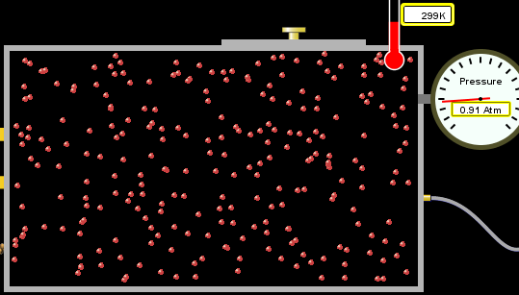
answer
For expandable container, set pressure constant

Slide 5
2. How does the pressure in the Helium balloon compare to the pressure of the air in the room? The pressure in the Helium balloon is
A. less B. equal C. greater
Notes:
b

Slide 6
3. How do the number of air molecules in the air balloon compare to the number of He atoms in Helium balloon? The number of air molecules is
A. less B. equal C. greater
Notes:
b

Slide 7


answer
For expandable container, set pressure constant

Slide 8
4. How does the average speed of the Helium molecules compare to that of the air molecules? The average speed of the He molecules is
A. less B. equal C. greater
Notes:
c

Slide 9


Answer to 4

Slide 10
Look at the animation of the particles bouncing around in the volume. Describe what visual information you can use to get a sense of the pressure that the gas particles are exerting on the walls.

Slide 11
Why does the pressure reading vary with time? What visual cues are associated with an increase in pressure?

Slide 12
5. What will happen to the pressure if temp is held constant and the volume is decreased?
Pressure goes up because more collisions
Pressure goes up because more collisions are happening, but same force per collision
Pressure goes up because more collisions are happening, and increased force per collision
Nothing because pressure is only related to molecular speed

Slide 13

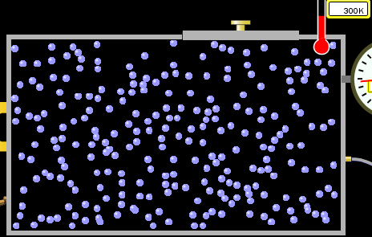

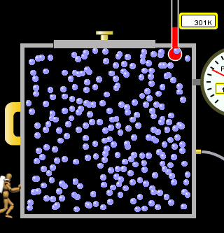
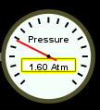
Answer to 5

Slide 14
14.7psi=1atm

Slide 15
The next slides follow the activity

Slide 16
Understanding physical change of gases continues
Learning Goals:
Describe a molecular model of gas pressure
Describe what happens to the measurable quantities if changes to the gas system are made.
Make sense of the measurable quantities of gases by analyzing examples of macroscopic things that are similar
Explain using physics what is happening on a molecular level when changes are made to a gas system.

Slide 17
6. You are flying from Denver to Boston, and you bring along a ½ full bottle of shampoo that was well sealed before you left Denver. You land in Boston and proceed to your hotel. The number of air molecules within the shampoo bottle:
A. has decreased
B. has stayed the same
C. has increased
Notes:
b

Slide 18
7. If the walls of the shampoo bottle are strong and rigid so that the bottle has the same shape as before you left, how does the pressure of the air inside the bottle compare to the pressure of the air in Denver?
less than
equal to
greater than
Notes:
b

Slide 19
8. How does the pressure inside the bottle compare to the pressure of the air in Boston?
less than
equal to
greater than
Notes:
a

Slide 20
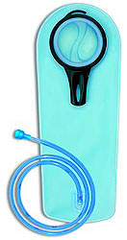
9. If you had a water bottle with very soft sides. When you open your suitcase in Boston, the bottle would look
squished
same size
puffed out
Notes:
a

Slide 21
What effects pressure for ideal gases?
Temperature
Number of particles
Volume
Mass of particles doesn’t effect pressure (Avogadro’s Principle)

Slide 22
Slides for next day

Slide 23
People who climb the tallest mountains in the world often use oxygen tanks to help them breathe. If a mountain climber asked you to explain the physics behind the “thin air”, what would you say to him?

Slide 24
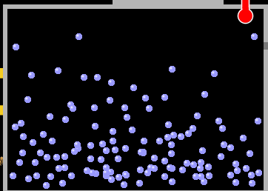

Gravity concentrates air closer to sea level

Slide 25
If you are in a building fire, you are supposed to lie on the ground. Why?
Notes:
Hot air rises and takes smoke, fresh air is more likely on floor. This has nothing to do with gravity

Slide 26
If you are hiking in the mountains and find yourself short of breath, do you think if you lie on the ground you could breathe easier?
Notes:
No, not enough change in gravity.

