Slide 1
Introduction to Magnets using Faraday’s Electromagnet Lab 1 by Trish Loeblein May 10, 2010 http://phet.colorado.edu
Learning Goals: Students will be able to
Predict the direction of the magnet field for different locations around a bar magnet and electromagnet.
Compare and contrast bar magnets and electromagnets
Identify the characteristics of electromagnets that are variable and what effects each variable has on the magnetic field’s strength and direction.
Relate magnetic field strength to distance quantitatively and qualitatively
Compare and contrast the fields of gravity and magnets qualitatively

Slide 2
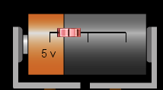
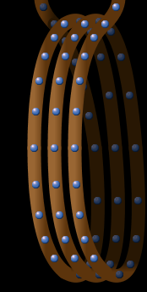
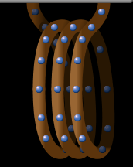
Which would be a more strong magnet?
A
B
They would be the same
Not enough information to decide
B
A
Notes:
A larger diameter provides more field. This is easily demonstrated on the generator tab

Slide 3
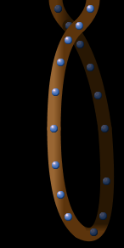
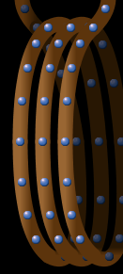
Which would be a more strong magnet?
A
B
They would be the same
Not enough information to decide
A
B
Notes:
B more coils provides more field. This is easily demonstrated on the generator tab

Slide 4





Which compass shows the correct direction of the magnet field at point A?
A
Notes:
D

Slide 5

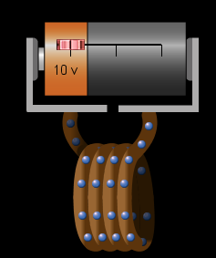
Which compass shows the correct direction of the magnet field at point A?
A
Notes:
A

