Slide 1
Resistors in Series and Parallel Circuits by Trish Loeblein phet.colorado.edu
Learning Goals: Students will be able to
Discuss basic electricity relationships in series and parallel circuits
Analyze the differences between real circuits and the simulated ones
Build circuits from schematic drawings
Use a multimeter to take readings in circuits.
Provide reasoning to explain the measurements in circuits.

Slide 2
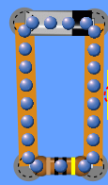
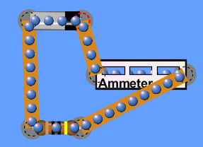

1. Which shows the correct way to use an ammeter?
A B
Notes:
B

Slide 3
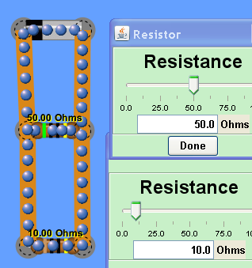
2. Which resistor will have the greatest current?
50 Ω
10 Ω
They have the same current
Notes:
B

Slide 4
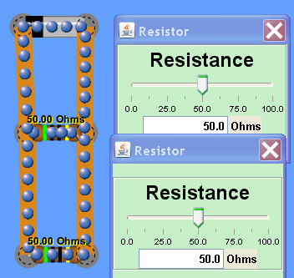
3. Which resistor will have the greatest current?
The top resistor
The lower resistor
They have the same current
Notes:
C

Slide 5
4. Which resistor will have the greatest voltage?
The top resistor
The lower resistor
They have the same voltage
Notes:
c

Slide 6
5. Which resistor will have the greatest voltage?
50 Ω
10 Ω
They have the same voltage
Notes:
C

Slide 7
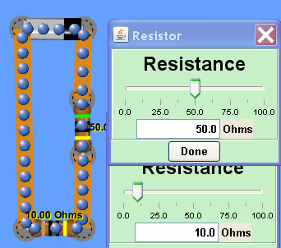
6. Which resistor will have the greatest voltage?
50 Ω
10 Ω
They have the same voltage
Notes:
A

Slide 8
7. Which resistor will have the greatest current?
50 Ω
10 Ω
They have the same current
Notes:
C

Slide 9
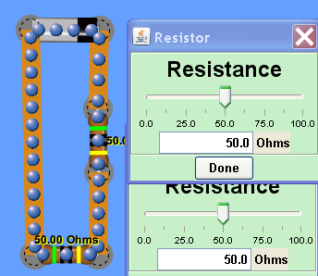
8. Which resistor will have the greatest voltage?
The top resistor
The lower resistor
They have the same voltage
Notes:
C

Slide 10
9. Which resistor will have the greatest current?
The top resistor
The lower resistor
They have the same current
Notes:
C

Slide 11
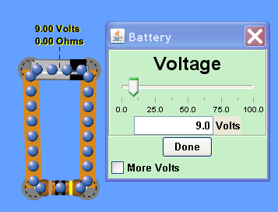
10. What will happen if the voltage of the battery is increased to 25 volts?
The voltage across the resistor will increase
The voltage across the resistor will decrease
The voltage of the resistor does not change
Notes:
A

Slide 12
11. What will happen if the voltage of the battery is increased to 25 volts?
The current through the resistor will increase
The current through the resistor will decrease
The current of the resistor does not change
Notes:
A

Slide 13
Combo Circuit Lab
Learning Goals: Students will be able to:
Analyze the differences between real circuits and the ideal ones,
Build circuits from schematic drawings,
Use a multimeter to take readings in circuits.
Provide reasoning to explain the measurements in circuits.

Slide 14
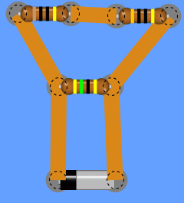
12. What is the total resistance in this circuit?
6.4 Ω
21 Ω
38 Ω
75 Ω
Notes:
B [1/(30+40) + 1/45]^-1 =21

Slide 15

13. What is the total resistance in this circuit?
6.4 Ω
21 Ω
38 Ω
75 Ω
Notes:
C. [1/(45+10) ]^-1 + 30=38

