Slide 1
Understanding KMT using Gas Properties and States of Matter
Trish Loeblein
Learning Goals: Students will be able to describe matter in terms of particle motion. The description should include
Diagrams to support the description.
How the particle mass and temperature affect the image.
How the size and speed of gas particles relate to everyday objects
What are the differences and similarities between solid, liquid and gas particle motion

Slide 2
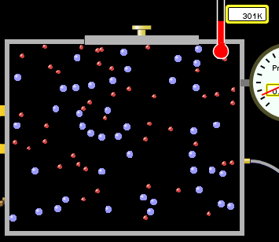
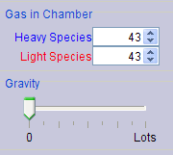
If you have a bottle with Helium & Nitrogen at room temperature, how do the speed of the particles compare?
All have same speed
The average speeds are the same
Helium particles have greater average speed
Nitrogen particles have greater average speed
Notes:
Use Gas Properties to show C is correct

Slide 3
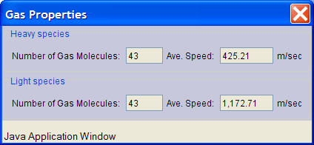
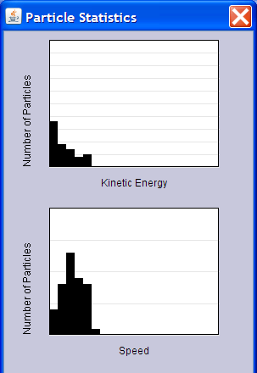
Light and heavy gas at same temperature 300K
Speed of each particle varies!!

Slide 4

What happens if you add energy using the heater?
All atoms speed up
All atoms speed up about the same
The lighter ones speed up more
The heavier ones speed up more
Notes:
A is the best answer, b is not true, the other options depend on how you define “more”, see next slide

Slide 5


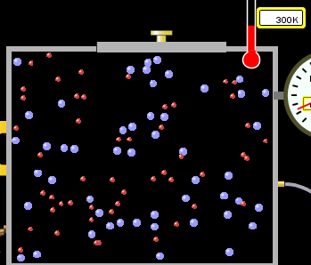
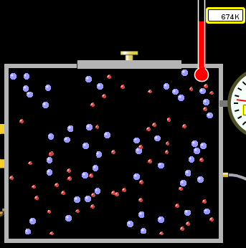
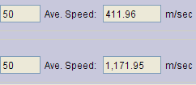

answer
Notes:
687/411=1.67 1516/1172= 1.3 So the light species doesn’t change by the same factor
687-411= 276 1516-1172= 344 nor does it just add.

Slide 6
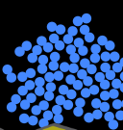
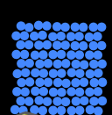
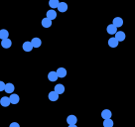
Which is most likely oxygen gas?
A B C
Notes:
C discussion how do you know?

Slide 7
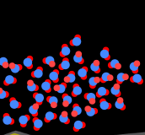
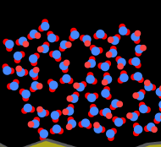
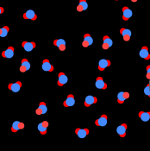
Which is most likely liquid water?
A B C
Notes:
discussion how do you know? A I am not sure that my students remember that water is less dense in solid form, but this would be a good time to remind them that ice floats.

Slide 8
How many water molecules are in a raindrop(.5 cm diameter). The molecules are about .1nm
If we just look at how many are across .005m/.1E-9m = 5E7 or 50 million.

Slide 9
To show vibration
http://chemeddl.org/collections/molecules/index.php
Check Spin Molecule to see 3D rotation
Show vibration under Normal modes of vibration (toggle down to see bond length changing)

Slide 10
KMT summary:
Matter is made up of particles having negligible mass are in constant random motion (vibrate, rotate, translate)
The particles are separated by great distances
The particles collide perfectly elastically (there are no forces acting except during the collision)
The temperature of a substance is related to the molecular velocity.

